Slide 1

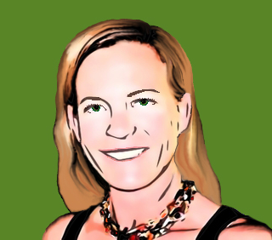

Pepper and Pear Instructional Design
Ack!
With Susan Boye-Lynn
Session Notes:
Please keep your mic muted when not speaking
Please open the Participant and Chat windows – use the to raise a question
Be aware that this session is being recorded
Notes:
Last week! But not your last chance to ask questions. Allen & Jenny – remember grad school and needing to be particularly kind to the department secretary so all paperwork went well…
This session is intended to be an opportunity to ask questions and seek answers.

Slide 2

Where has the summer gone?
Where are you now?
Notes:
Poll: How confident are you now?

Slide 3

Ack! Topics for Troubleshooting
Presentation Back-end
Prep Toolkit File Structure
Filing in Drive
Google Forms & Sheets
Zoom Questions
Homepage Recommendation
Notes:
Presentation Back-end
Prep Toolkit File Structure
Filing in Drive
Google Forms & Sheets
Zoom Questions
Reducing Platform Fatigue

Slide 4
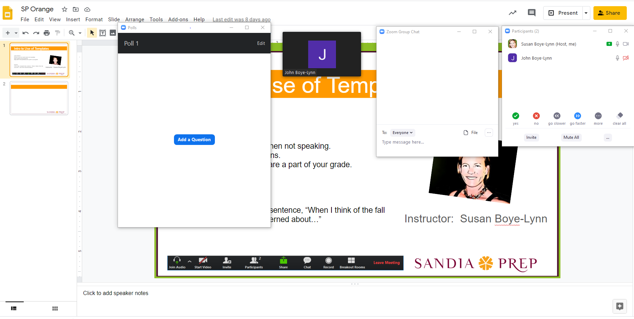
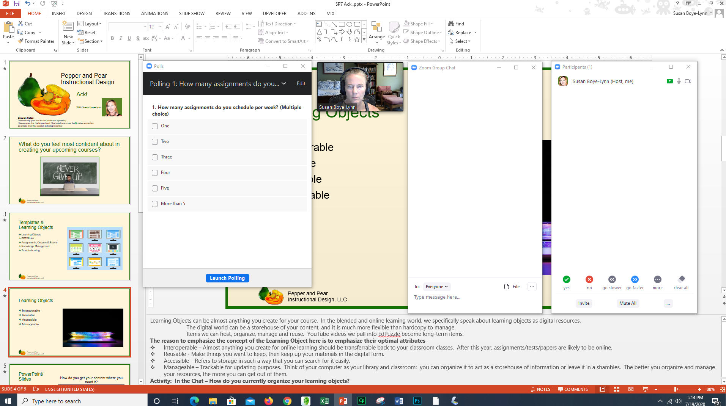
Presentation Back-end
Notes:
Presentation Back-end
My view is based on a two screen set up using PPT and sharing the “Presentation” as a slideshow on another screen.
Items I pull in to my presentation view: Polling, Video, Chat & Participant Windows. Note that the chat and video are toward the center, that is because of my camera – so my camera angle looks attentive to chat & video.
You can also replicate this using Google Slides
Questions?

Slide 5
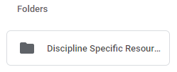
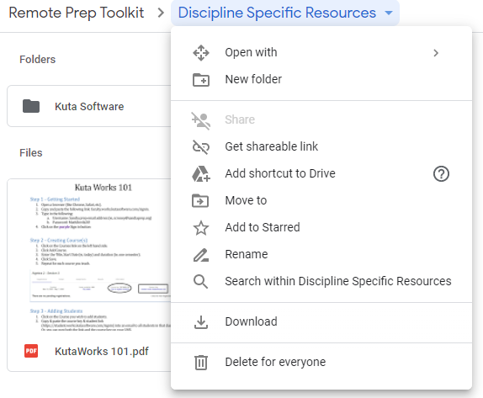
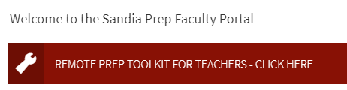
Prep Toolkit File Structure
Toolkit Banner on Homepage
Folder - Discipline Specific
How to Add Folders
Naming Protocols
Notes:
Toolkit Banner on Homepage
Folder - Discipline Specific
How to Add Folders – Recommendation – Talk with your colleagues regarding file structure options
Naming Protocols – Recommendation F/S Year, Subject Abbrev., Title Abbrev.
Allen?
Questions?

Slide 6
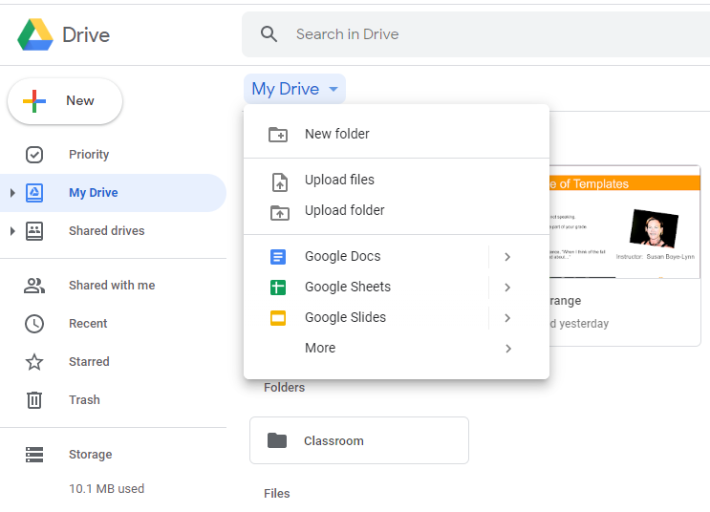
Filing in Drive
Go to My Drive
  Use the Dropdown
  Select New Folder
  Can repeat within folders
Notes:
Go to My Drive
Use the Dropdown
Select New Folder
Can repeat within folders
Jenny?
Activity: Questions?

Slide 7
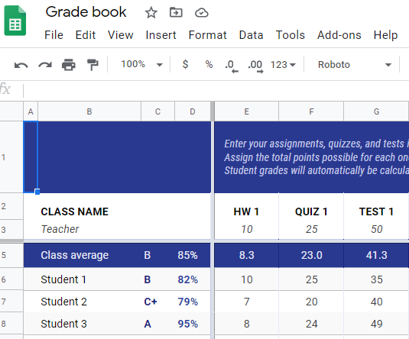
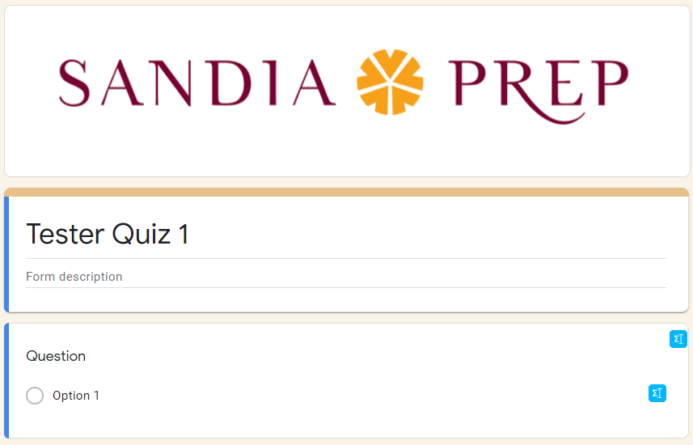
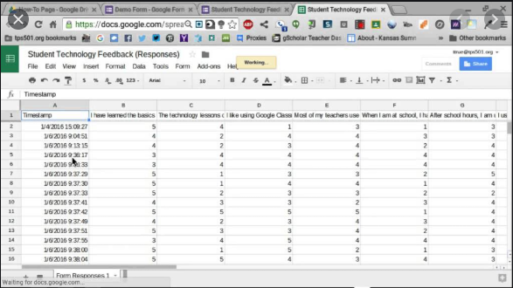
Google Forms & Sheets
EDU in 90 by Google
Notes:
Create and grade quizzes using Google Forms: https://goo.gl/T43P4X
Send scores via email: https://goo.gl/RVgQa6
Grade and return a Google Forms Quiz through Google Classroom: https://goo.gl/gBiRJw
Create & manage Forms Questions in Sheets: https://www.youtube.com/watch?v=K8igetxgGdQ
Good news – You can auto add to your Sheets Gradebook.
Bad news – They will not auto-add to the VeraCross gradebook. – HUGE PUSH HERE: grades are a massive part of student confidence and a connection point. Grades are a massive part of presence.
Allen?
Activity: Questions?

Slide 8
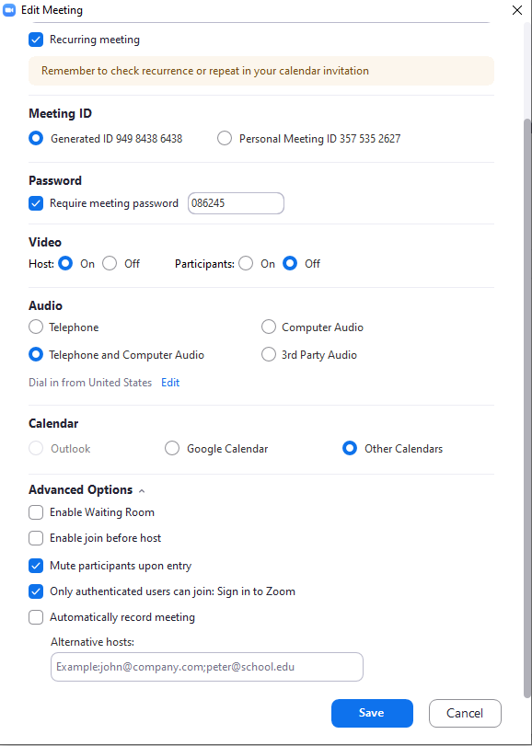
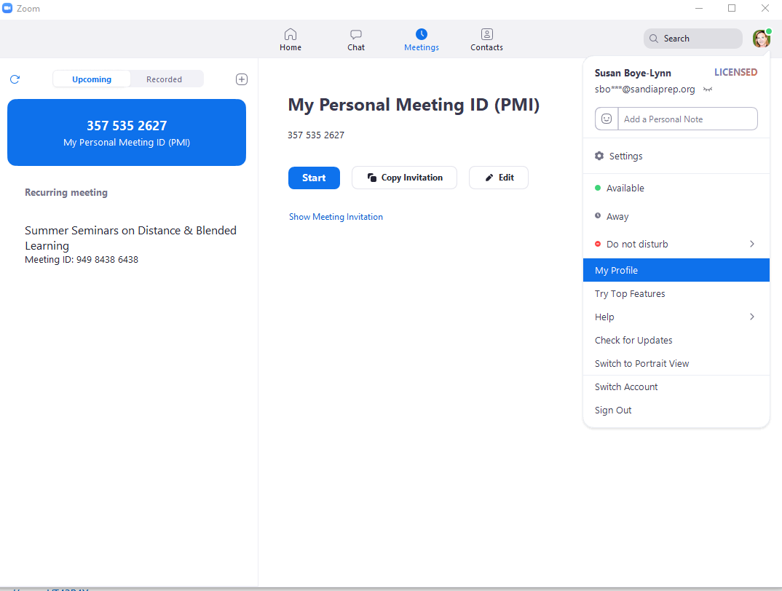
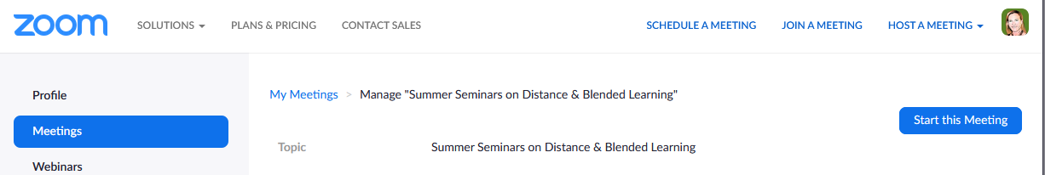
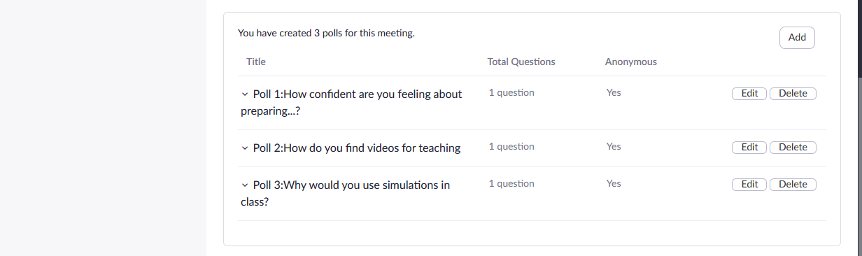
Zoom Questions
Personal Meeting ID vs. Dedicated Meetings
Advanced Options
  Enable Waiting Room
  Enable join before host
  Mute upon entry
  Only Authenticated Users
  Recording
Break out room pre-assign
Where are the Polls?
Standard settings?
Notes:
My Personal Meeting ID – Use vs. Dedicated Meetings for Classes – Recommendation: save the Personal Meeting ID for office hours, make meetings for each course (you can copy the first one you make, but then you are able to create polls for each separately.
Advanced Options – List above - Only Authenticated users can join – Authenticated Users are your Sandia Prep students, I believe this is a default setting for prep meetings.
Need to go to Profile for Breakout Room Controls
Breakout Rooms Pre-Assign – I do not have that option in the meeting settings, if that is available to faculty, here is the URL https://support.zoom.us/hc/en-us/articles/360032752671-Pre-assigning-participants-to-breakout-rooms
Polls
Standard Settings
Jenny?
Activity: Questions?

Slide 9
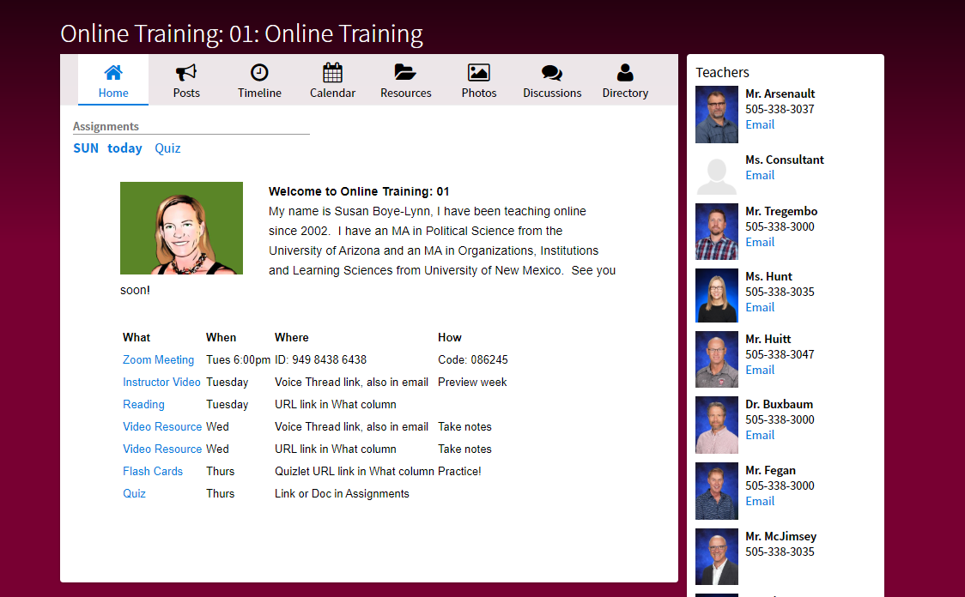
Homepage Recommendation
Instructor Graphic
Short Course Intro
Linked Resources Table
Notes:
Query was: how do we reduce platform fatigue – one of the best ways is to be constantly aware of exactly what you are asking the students to do – and making the students aware as well
Recommendation: to have consistent homepages which provide links to all resources.
Putting links in text in Google Docs: https://www.youtube.com/watch?v=DasvpzvZxfM

Slide 10
Questions?
Reactions?
Contact Information:
Susan Boye-Lynn
sboye-lynn@sandiaprep.org
boyelynn@comcast.net
Notes:
Thank you for having me!

