Slide 1

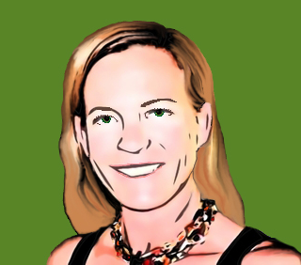

Pepper and Pear Instructional Design
Templates &
Learning
Objects
With Susan Boye-Lynn
Session Notes:
Please keep your mic muted when not speaking
Please open the Participant and Chat windows – use the to raise a question
Be aware that this session is being recorded
Notes:
We spoke in the first session about Sequencing so you can stay sane. A lot of that message was that by parsing your content between platforms. You can pre-program items for later delivery.
Today’s topic is the core of how you build the items you need. So, now is the time to consider which items you assign would be best distributed through which platform.
Do you want to take up class time with quizzes, when you get so little class time? Or perhaps you use quizzes as a learning experience with immediate grading that and discussion that is BEST done in class.
There isn’t one way to do this, but good design means carefully deciding where content is best deployed.

Slide 2


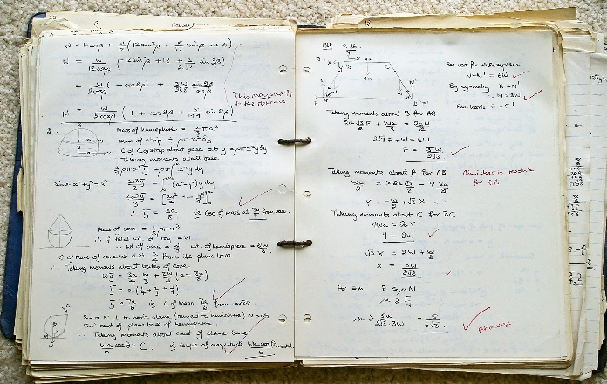
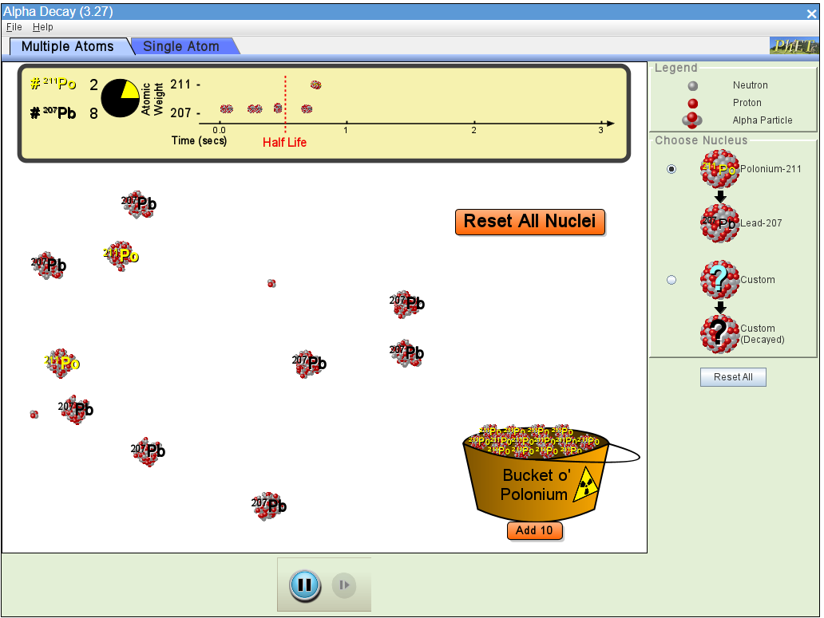




How many assignments do you schedule per week?
Notes:
How many assignments to you schedule per week?
POLL: How many assignments do you schedule per week?

Slide 3
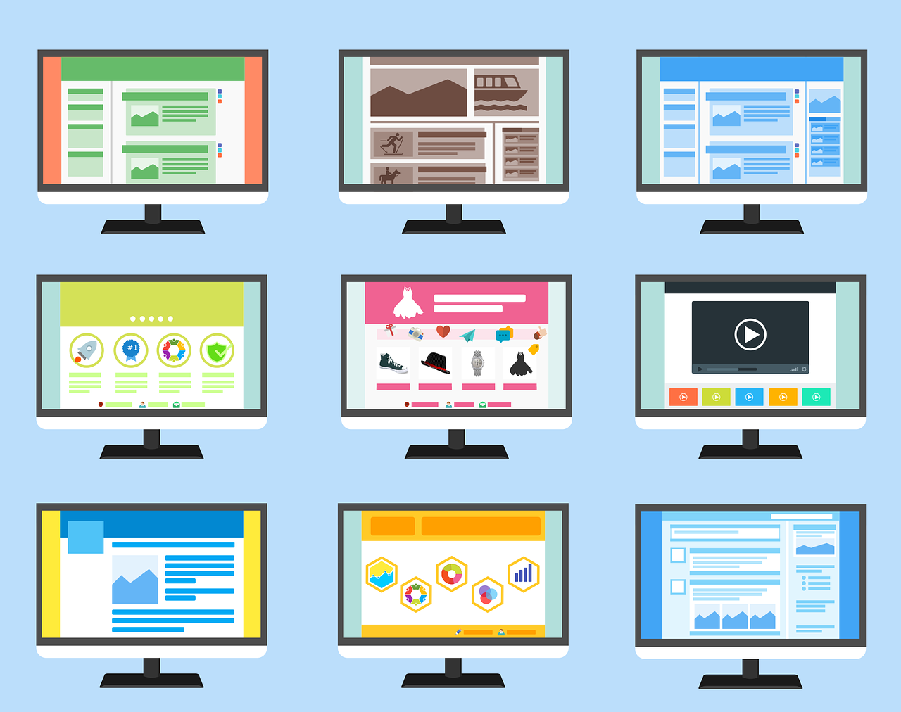
Templates & Learning Objects
Learning Objects
PPT/Slides
Assignments, Quizzes & Exams
Knowledge Management
Troubleshooting
Notes:
Learning Objects
Tools for Building
PPT/Slides
Assignments, Quizzes & Exams
Knowledge Management

Slide 4

Learning Objects
Interoperable
Reusable
Accessible
Manageable
Notes:
Learning Objects can be almost anything you create for your course. In the blended and online learning world, we specifically speak about learning objects as digital resources.
The digital world can be a storehouse of your content, and it is much more flexible than hardcopy to manage.
Items we can host, organize, manage and reuse. YouTube videos we pull into EdPuzzle become long-term items.
The reason to emphasize the concept of the Learning Object here is to emphasize their optimal attributes
Interoperable – Almost anything you create for online learning should be transferrable back to your classroom classes. After this year, assignments/tests/papers are likely to be online.
Reusable - Make things you want to keep, then keep up your materials in the digital form.
Accessible – Refers to storage in such a way that you can search for it easily.
Manageable – Trackable for updating purposes. Think of your computer as your library and classroom: you can organize it to act as a storehouse of information or leave it in a shambles. The better you organize and manage your resources, the more you can get out of them.
Activity: In the Chat – How do you currently organize your learning objects?

Slide 5
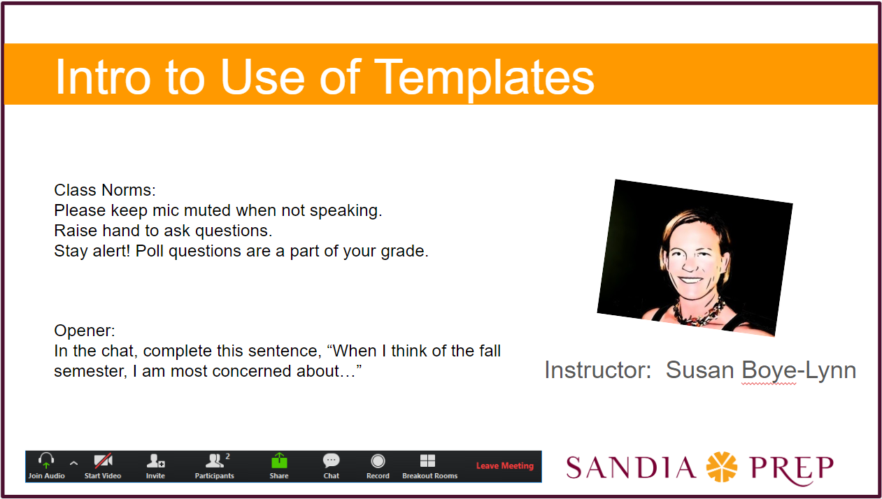
PowerPoint/
Slides
How do you get your content where you need it?
Sequencing Presentations
Explanatory Graphics
Lecture Notes
Additional Resources
Links to Assignments
Activity Reminders
Notes:
PowerPoint/Slides – Best location for your base content,
What you use for classroom and for virtual classes.
Sequencing Presentations – keep yourself on track
Explanatory Graphics – have them at hand, keep extra slides (hidden) so that you can get to what you need
Lecture Notes – Putting notes in presentations tends to reduce extended discourses into teachable chunks
Additional Resources – Videos, Audio, URLs to Sims, Debates, etc…
Links to Assignments – Doc & Forms URLs
Activity Reminders – Questions, Polls, Breakout Room Plans
Activity: Hand Raise – How many of you already have presentations in slide form? Question for response: What would make it easier for you to set them up?

Slide 6
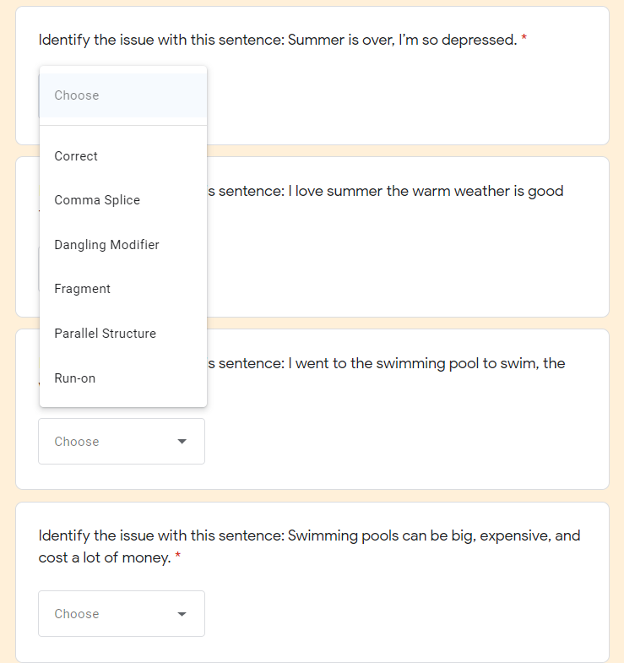
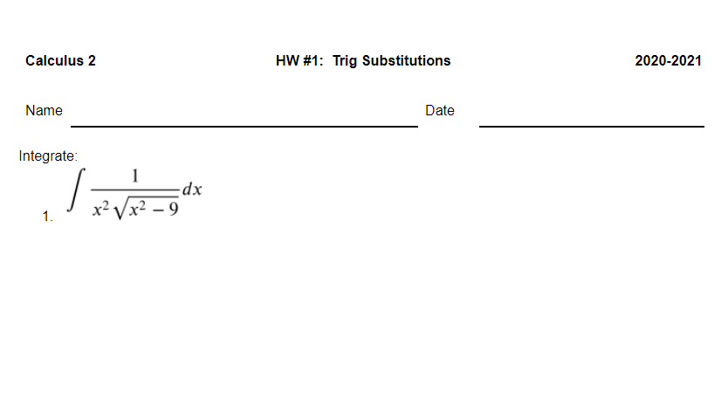
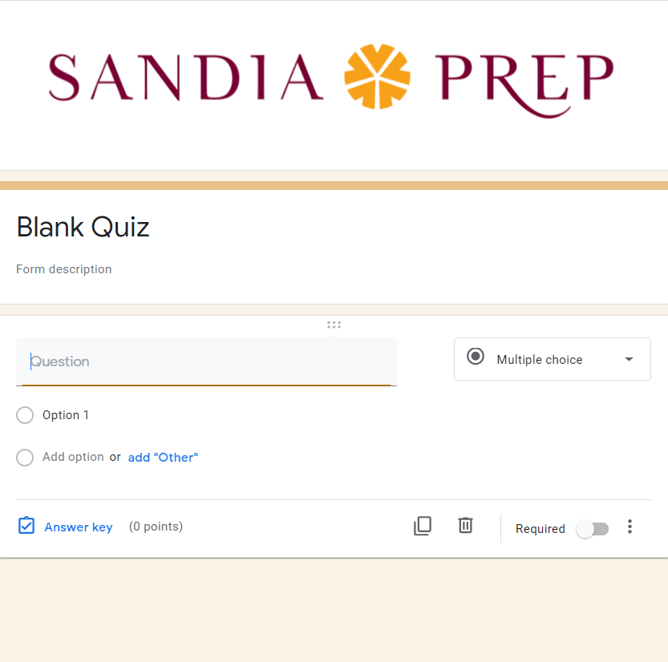
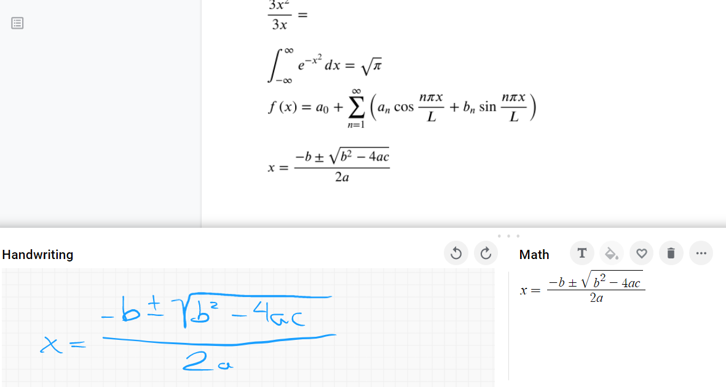

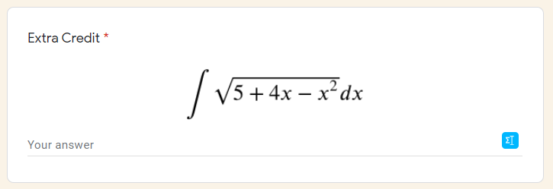
Assignments, Quizzes & Exams
Google Forms
Google Sheets
  Flubaroo
Google Docs
  Turn-it-in
  EquatIO
Notes:
Google Forms – While this is a format that elongates the page view, it is more flexible than you may think. Basic Questions: Name, Email, Date & Time
Short Answer
Long Answer
Multiple Choice – T/F – MC Grid
Drop Down
Linear Scale
Whatever you build can be reused – mixed and added to create a later assessment.
Google Sheets – Flubaroo https://www.youtube.com/watch?v=U06W3H_iDho
Google Docs - Turn-it-in, EquatIO – Note: if you want to make a Template, create the doc, then go to File/New/from Template. From there you can select upload new Template.
Questions? Please feel free to unmute to ask.

Slide 7


Knowledge Management
Presentation Slides
Graphics
Texts
Video/Audio Resources
Lecture Notes
Assignments
Test Questions
Simulations/Labs
Performances/Exhibitions
Notes:
Presentation Slides
Graphics
Texts
Video/Audio Resources
Lecture Notes
Assignments
Test Questions
Simulations/Labs
Performances/Exhibitions
Activity: Breakout – Discuss which courses might have overlap for useful sharing of content.

Slide 8

Troubleshooting
How can I help you?
Notes:
Next week is entirely about your questions. If you have something I can prepare, I am happy to do that. We can start right now…

Slide 9
Questions?
Reactions?
Contact Information:
Susan Boye-Lynn
sboye-lynn@sandiaprep.org
boyelynn@comcast.net
Notes:
Next Week: Ack!

