Slide 1

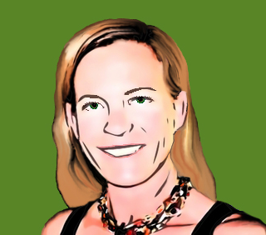

Pepper and Pear Instructional Design
Resources in
Blended
Learning
With Susan Boye-Lynn
Session Notes:
Please keep your mic muted when not speaking
Please open the Participant and Chat windows – use the to raise a question
Be aware that this session is being recorded
Notes:
Today is about how to use resources in Blended and online learning. At the end, I have a smorgasbord of websites with resources that I have checked were still up to date as of this week.

Slide 2






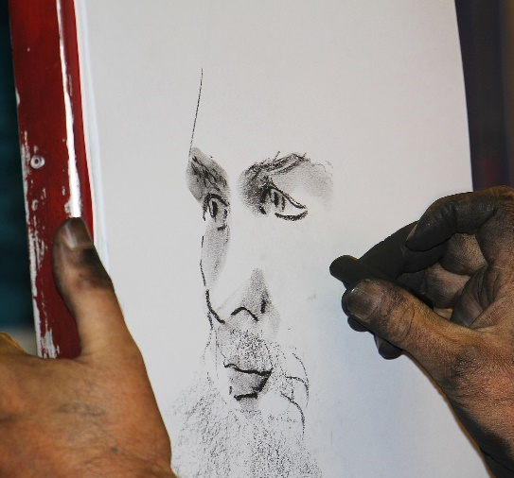

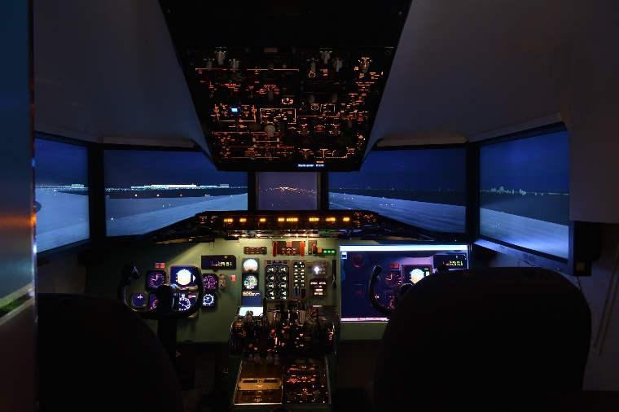
What is your best resource for teaching?
Notes:
On here I have put examples of resources: textbooks, videos, websites, white/blackboard, games, experiments, activities/practicals, recording, simulations
Opener Chat: What is your best resource for teaching your subject?
We often overlook the most important items… We want to narrow in on the “hub” of your learning content.
“Cool” resources can pull your content one direction or another. Avoid letting the resources overwhelm your main content.
As we go through the resources today, please keep in mind your “hub” resource, and consider options based on how well they can and will integrate.

Slide 3

Resources in Blended Learning
Be Selective and Stable
Websites
Virtual Spaces
Videos
Games
Simulations
Notes:
Topics for tonight include:
The Importance of Being Selective and Stable
Websites
Virtual Spaces
Videos
Games
Simulations
Note: discussion is NOT about apps. That is an entirely different topic, and require a lot of coordination with the various IT administrators, and checking against the student technology base.
Talk with Jenny and Allen about apps.

Slide 4






Be Selective and Stable
Consistency is Reassuring
Simple is Often Better
Student Tech can be a Barrier
Select for Impact
Select for Tool Usage
Select for Larger Lessons
Time for a Poll!
Notes:
Consistency is Reassuring – Consider how many platforms and elements you need – and how many your students are experiencing…
Keep a limit on new/added platforms and programs – try only 1 per week.
Signal any changes in platforms or programs in your weekly introductory video.
Be ready for platform questions and issues, have alternates in mind for everything.
Simple is Often Better – The main question is: does this convey what I need it to convey?
Student Tech can be a Barrier – Test Test Test, ask colleagues to test on tech that you don’t have. Mac meet PC. PC meet Mac.
Select for Impact – sometimes you just need a video to convey visual impact, sometimes a simulation is the only way – consider how impactful the tool is and whether it does what you need (BaFa)
Select for Tool Usage – it is very easy to get caught up in tools, usage is key
Select for Larger Lessons – sometimes the lesson is a longer process which requires extended and connected lessons – a long-term simulation may be optimal here (Model UN)

Slide 5
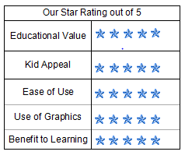

Websites
Initial Impression
Information Type
  News (commercial?)
  Original Research
  Government Data
  Commercial/Opinion
Publisher
External Perspective
Website’s Perspective
Website’s Intended Audience
Does the website have ads?
Notes:
Websites – most often misused resources: some are simply a great way to see something that is otherwise unattainable – Museums, Cities, National Monuments all have Virtual Tours,
Websites give access to institutions, which is important knowledge for students – As you look at them you need to discern a number of
Initial Impression – Is the content appropriate? Is it complete? Is it credible?
Information Type - News, Original Research, Government Site, Commercial/Opinion
Publisher – Who owns the site and what do they have to gain by it?
External Perspective - What do other websites say about it?
Website’s Perspective – What agenda is being pushed?
Website’s Intended Audience – Who else would you expect to use this site?
ADS? – need to check this!!!
Hands – How many of you post websites for students to use? How many of you fill out a basic Website Evaluation Form for your records before posting the site?
Evaluation forms – free https://www.sampleforms.com/sample-website-evaluation-form.html

Slide 6
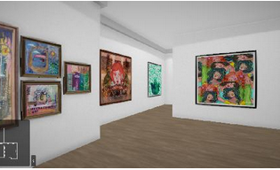
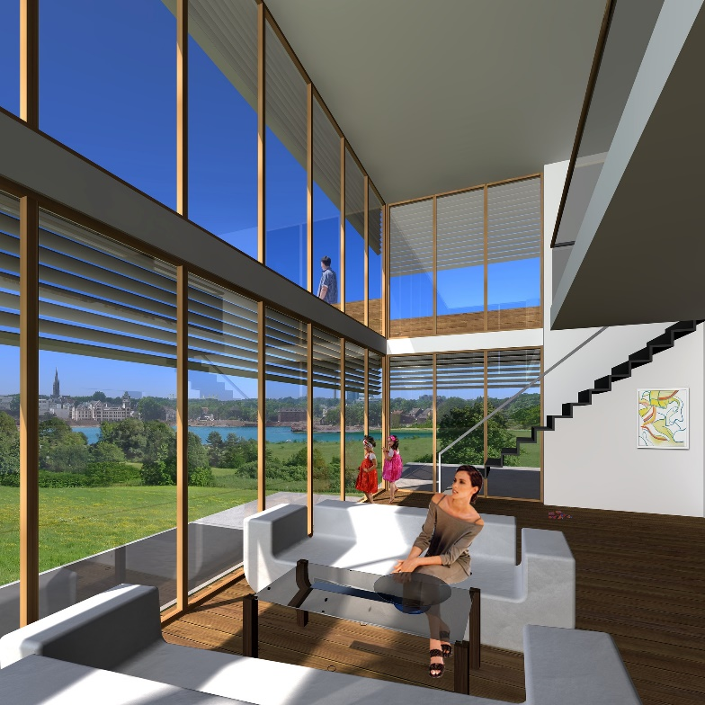
Virtual Spaces
Galleries
Communication Hubs
Virtual Worlds
  Meeting Places
  Pre-Programmed Education
  Programmable Space/Sims
Notes:
Virtual Spaces are unique online environments – most allow for multi-user collaboration, communication and discovery. Some very simple examples can be very powerful:
Galleries –Virtual Art gallery – Art Steps https://www.artsteps.com/
Communication Hubs – Social Media, Zoom, or any gallery that allows interaction – Caution: need to understand the nature of the platform and privacy settings.
Virtual Worlds
Meeting Places - 2nd Life
Pre-Programmed Education – Minecraft
Programmable Space/Sims – OpenSim/Sim-on-a-Stick
Tech is the main issue here for accessibility & time – Second Life will require two sessions JUST TO SET UP AVATARS and learn controls
Some students will be easy adopters – some will be incredibly slow to manage the controls - and their parents will simply not have a clue…
Raise Hands – How many of you think you may consider using virtual spaces? (offer to help)

Slide 7

Video
Instructor Intro Video
Instructional Video
  EdPuzzle
  YouTube/TED/IQ²
  Websites
  Build using VT
Demonstrations
Time for a Poll!
Virtual Ground
Notes:
Instructor Intro Video
Instructional Video
EdPuzzle – really nice way for you to use Knowledge Management – to pull in items for your school’s use and to swap useful learning objects.
YouTube/TED/IQ2 (pull short video into EdPuzzle to avoid ads and linking)
Websites (look for embed codes, https://www.google.com/search?channel=cus3&client=firefox-b-1-d&q=embed+code)
Build using VT
Demonstrations – find online or build using VT https://www.techsmith.com/blog/instructional-videos/
Note: Flash is going unsupported this year. ALL OLD VIDEOS MAY STOP WORKING
Poll: How do you find videos for teaching?

Slide 8

Games
Games – create engagement through real-time action/reaction chains.
Facilitate & Augment Learning
Current online games
Notes:
Facilitate & Augment Learning - Immediate feedback
Current online games -
Test Review: Flash Cards, Jeopardy -
Pros: engagement, real-time interaction
Cons: may divert from learning, additional costs
Share in the chat: What is your favorite game to use in class?

Slide 9

Simulations
Simulations – at the core are about things or systems and how they behave.
Model Real-World Safely
Provide Analytical Tools
Insight into Dynamics
Allows Visualization
Time for a Poll!
Notes:
The goal of a simulation is to provide an immersive experience.
Model Real-World Safely – Cultures, Interactions,
Provide Analytical Tools – Create data pools for analysis
Insight into Dynamics – Look at how a system works – Model UN
Allows Visualization – Interactive perspective with deeper understanding Using BaFa BaFa in IR
Simple ones can be created fairly easily. Once the mechanisms are set up, then it can run repeatedly.
Poll: Why would you use simulations in class?

Slide 10
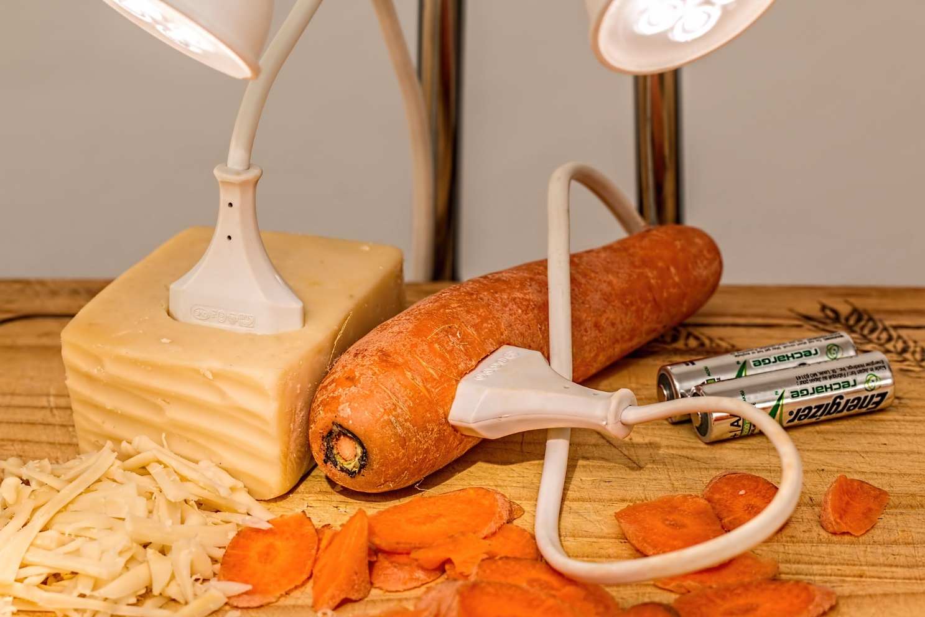
In Closing
Simpler is still often better
Technology is not universal
Research is usually faster than building
Notes:
Simpler is still often better
Technology is not universal
Research is usually faster than building

Slide 11

Resources:
Academic Earth https://academicearth.org/
Annenberg Classroom https://www.annenbergclassroom.org/
BBC iReporter https://www.bbc.co.uk/news/resources/
Big History Project https://www.bighistoryproject.com/home
CK-12 https://www.ck12.org/teacher/
Digital Civics Toolkit https://www.digitalcivicstoolkit.org/
Docs Teach https://www.docsteach.org/
EDSITEment https://edsitement.neh.gov/
EdPuzzle https://edpuzzle.com/home
EdX https://www.edx.org/
Geoguessr https://www.geoguessr.com/
Google Arts & Culture https://artsandculture.google.com/
Lesson Planet https://www.lessonplanet.com/
Library of Congress https://www.loc.gov/education/
Little Alchemy https://littlealchemy.com/
Merlot https://www.merlot.org/merlot/index.htm
Minecraft Education https://education.minecraft.net/
NOVA https://www.pbs.org/wgbh/nova/
OER Commons https://www.oercommons.org/
Open Sim http://opensimulator.org/wiki/Main_Page
Parable of the Polygons https://ncase.me/polygons/
PBS Learning https://nm.pbslearningmedia.org/
Arthur Lakes Library https://libguides.mines.edu/oer/simulationslabs
PhET Sims https://phet.colorado.edu/
Pixabay https://pixabay.com/
Prodigy Game https://www.prodigygame.com/
ReadWriteThink http://www.readwritethink.org/
Second Life http://go.secondlife.com/landing/education/
Smithsonian https://www.si.edu/educators/resources
Stanford History https://sheg.stanford.edu/
TED https://www.ted.com/
Type Tastic https://edu.typetastic.com/
W3 Schools https://www.w3schools.com/
AnyLogic https://www.anylogic.com/s/download-free-simulation-software-for-education/
Questions?
Reactions?
Contact Information:
Susan Boye-Lynn
sboye-lynn@sandiaprep.org
boyelynn@comcast.net
Notes:
Next Week: Templates & Learning Objects
Final Feedback: What Templates do you need? Or do you? What sort of assignments do you find it difficult to format for online use?

