Slide 1



Pepper and Pear Instructional Design
Selective Assessment Methods
With Susan Boye-Lynn
Session Notes:
Please keep your mic muted when not speaking
Please open the Participant and Chat windows – use the to raise a question
Be aware that this session is being recorded
Notes:
Today’s Goal: Talk through assessment in online learning.
Distinction: a test is a product – a knowledge check that is part of the learning objects. When we use a knowledge check to look at our instruction, then we are assessing the learning and learning objects.
So today will be about the use of tests for students, but also about how to use the knowledge checks we build for learning assessment.

Slide 2

How do you know when someone has learned?
Please feel free
to raise your hand and unmute your mic to respond.
I trust you to respect each other.
Notes:
How do you know when someone has learned? Discussion
How do you know when your teaching affected that learning outcome?

Slide 3

Selective Assessment Methods
What do we mean by Assessment?
Types of Assessment
Assessment as Presence
Assessment as Knowledge
Formatting for Online
Getting Fancy –
  Collaborative Learning
Notes:
What do we mean by Assessment?
Types of Assessment
Assessment as Presence
Assessment as Knowledge
Formatting for Online
Getting Fancy –
Collaborative Learning

Slide 4




What do we mean by Assessment?
A Different Set of Metrics
Assessing Teaching Strategies
Demonstrating Effectiveness
Notes:
Classroom learning usually utilizes summative and criterion referenced assessments,
A different set of metrics - Higher tendency to require learning assessment for blended and online learning suddenly people start asking about assessment for your class sessions, quiz questions, and virtually any assignment. This can be tasking if you are not aware of this in advance.
Assessing Teaching Strategies – As we create learning objects, particularly tests, we need to design to look for the back end indicators of how well received and understood the material was by the students. Setting up test reports can help indicate where questions may have been misunderstood, or where distractors are problematic.
In blended and online education, being able to show the way the curve moves is imperative. You want to be able to show that course materials produce a better than normal curve outcome.
Demonstrating effectiveness –This is what parents want to see: that you are moving their students’ curve.
Assessment is about ensuring you are getting the data on the back end regarding how your students are responding to the course. (NC Physics Instructor)
Chat: Have you experienced these sort of questions regarding metrics for your course assignments?

Slide 5

Types of Assessment
Pre-Assessment/Diagnostic
Formative
Summative
Confirmative
Norm-Referenced
Criterion-Referenced
Ipsative
Time for a Poll!
Notes:
Pre-Assessment/Diagnostic – knowing what kinds of students you have
Formative – Early in the semester in a course, determining what works for the students – identifying gaps in knowledge and even instructional style – IF YOU CAN BE FLEXIBLE…
Summative – End of instruction or benchmark checks on meeting outcomes
Confirmative – Long term post instruction check
Norm-Referenced – performance compared to an average
Criterion-Referenced – performance against predetermined criteria – learning objectives
Ipsative – measure against prior performance
Poll: Which kinds of Assessments do you currently use?

Slide 6

How a Week Can Work
Assessment = Presence
Friday | Weekend | Monday | Tuesday | Wednesday | Thursday
Email 8-5 Office Hours Grading Post: Reading/Lesson Discussion Board Quiz: Lvl 1 Assign: Lvl 2 Project: Lvl 3-6 Class Activity Update Page |  | Email 8-5 Class Activities Office Hours | Email 8-5 Class Activities Office Hours | Email 8-5 Class Activities Office Hours | Email 8-5 Class Activities Office Hours
Asking Questions Get Grades Get Work | Scheduling Work Reading Working Ahead | Class Activities | Class Activities Quiz: Lvl 1 DB Posts | Class Activities Assign: Lvl 2 DB Response | Class Activities Project: Lvl 3-6 DB Ex Credit
Instructors
Students
Notes:
From the first week: demonstration of pre-programmed assessments as creating PRESENCE… Class Meeting: Wednesday…
How can you know what they are doing? How can you assess their learning and the way the students are reacting to the assignments? Pre-programmed checks.
Student motivation is fundamentally linked to consistent assessment in online learning (Turner & Briggs, 2018).
If students can reliably get grades back from you on Friday as well as a new audio/video/module, then on Tuesday and Wednesday they also have other items which are turned in to you that have auto-grading built in, then they are getting four or five interactions with you before you even get to the discussion board posting.
I can’t emphasize enough how beneficial it is to students to have these continual checks, particularly when you provide feedback in the pre-programmed quizzes. Assessment = Presence
Activity: Hand raise – how many of you have started to pre-program your quizzes for the fall and spring?
Chat: What platforms are you using to create your quizzes? How do you plan to move the scores to your grade book?

Slide 7

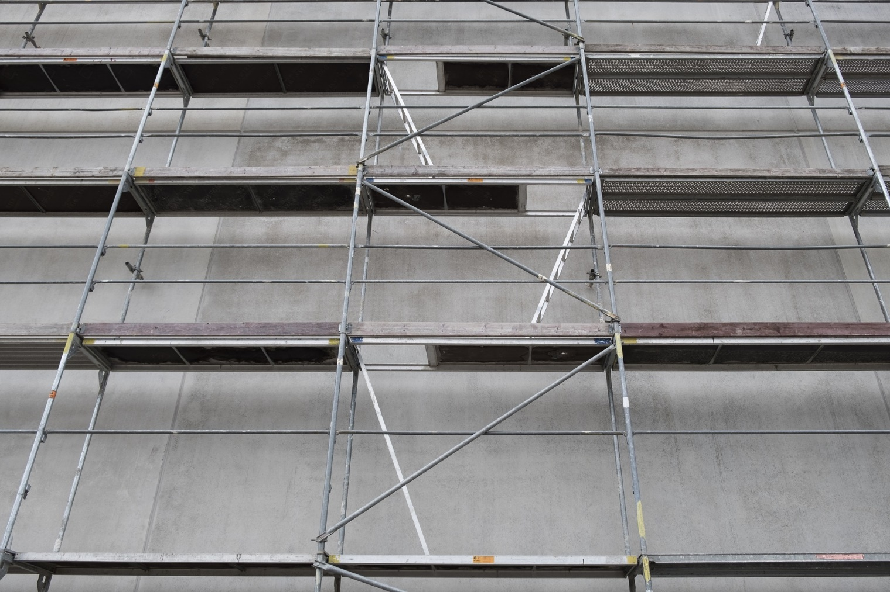



Scaffolding in Blended Learning
Assessment = Knowledge
Bloom’s Taxonomy
Top Level Work
Analysis
Evaluation
Synthesis
Experiments
Discussions
Demonstrations
Application
Reading Comprehension
Relationships between Terms
Explaining Functions
Understanding
Knowledge
True/False
Multiple Choice
Definitions
Identifying Components
Notes:
The question is how you can set up your assignments so that the back-end provides sufficient information for assessing the learning and learning objects.
Our best bet is to turn to our departmental groups to find solutions.
We need to organize tonight, Math, Science, Language Arts, Humanities, (PE in with Science & Art in with Humanities)
Talk this through – will upper school and lower school of each work?
Breakout by field: What sort of data would be most useful for your department to have to demonstrate effective learning?

Slide 8
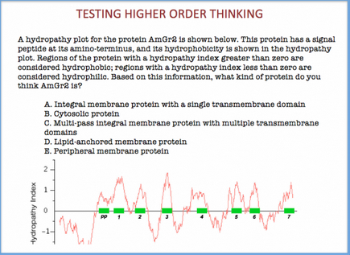

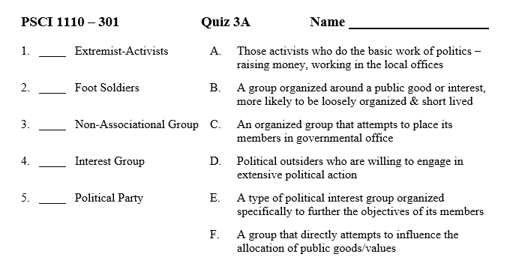

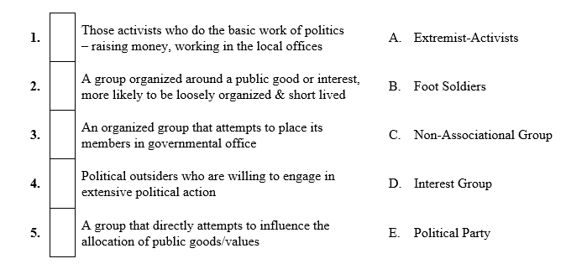
Formatting for Online Delivery
Use Pre-tests (Ungraded)
Switch Sides
Recognize Cognitive Load
Gradability by Question Type
FEEDBACK!!!
Notes:
Use Pre-tests (Ungraded) - With the higher level of scrutiny, using pre-tests to get a base-line. Pull about 10 indicator questions per unit, something that would normally be on a test, and something you feel is often misunderstood. These should be UNGRADED checks.
Switch Sides – don’t use old formats
Recognize Cognitive Load (spatial issues with computer pagination)
Gradability by Question Type – Use the gradability of certain question types to build meaningful assessment that have feedback
FEEDBACK!!! – They should at least receive an immediate score and correct answers for all items possible, and at the latest weekly feedback on short answers.
Writing High Difficulty Multiple Choice Questions https://testing.byu.edu/handbooks/14%20Rules%20for%20Writing%20Multiple-Choice%20Questions.pdf
https://cft.vanderbilt.edu/guides-sub-pages/writing-good-multiple-choice-test-questions/
Open for Questions – audio or chat

Slide 9
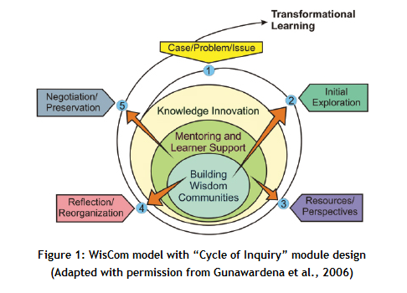
Getting Fancy -
Collaborative Learning
WisCom – Wisdom Communities
Mentoring/Learner Support
Designing for Assessment
  Develop a Case/Problem
  Create – interaction
  Record – archiving/reporting
  Access – retrieval for other uses
  Enable – relate knowledge to individual/community learning goals
Notes:
The WisCom Option– designed for online learning inquiry
At the center is the idea of building wisdom communities - this model is concerned with the entire flow of communication and collaborative efforts.
Mentoring/Learner Support – This is what changes us from a collaborative model that forms-storms-norms, then performs to a learner support model that gets the performing happening quickly
Designing for Assessment – the instructor is designing interactions to help guide learners to effective methods for group participation.
So the design needs to reflect this learner support as a part of the cycle of inquiry.
I am going to do a brief overview of this model, then go to what an example might look like – PLEASE – ask questions when you have them…
URL: http://web.b.ebscohost.com/src_ic/pdfviewer/pdfviewer?vid=2&sid=8dada786-41f9-4612-a1d8-3c858413159d%40pdc-v-sessmgr05
Distance Education, Vol. 27, No. 2, August 2006, pp. 217–232 New Model, New Strategies: Instructional design for building online wisdom communities Charlotte N. Gunawardena*, Ludmila Ortegano-Layne, Kayleigh Carabajal, Casey Frechette, Ken Lindemann and Barbara Jennings University of New Mexico, USA

Slide 10
Getting Fancy -
Collaborative Learning
Instructor | Assessment | Community | Individual | Product
Present Case
Initial Exploration | Discussion Board | Initial Exploration |  | DB Interaction
Resources/Perspectives Learner Support | Resource Report Feedback |  | Resource Report | Resource Worksheet
 | Resource Agreement | Resource Review Record & Archive |  | Resource Agreement
Reflect/Organize | Discussion Board | Access resources for problem solving – Parse out project areas |  | DB Interaction
Negotiation/Preservation Learner Support | Solution Report Feedback |  | Solution Report | Solution Worksheet
 | Solution Agreement | Negotiation & Preservation |  | Solution Agreement
Enable Learner Support | Section Review Feedback |  | Section Write up | Section Review
 | Final Plan | Reviews & approves sections |  | DB Interaction Final Plan Write up
Notes:
Example walk-through. – With online inquiry, you don’t have the same “check-ins” that you get with f2f classes. Getting the temperature of a group is much more difficult.
URL: http://web.b.ebscohost.com/src_ic/pdfviewer/pdfviewer?vid=2&sid=8dada786-41f9-4612-a1d8-3c858413159d%40pdc-v-sessmgr05
Distance Education, Vol. 27, No. 2, August 2006, pp. 217–232 New Model, New Strategies: Instructional design for building online wisdom communities Charlotte N. Gunawardena*, Ludmila Ortegano-Layne, Kayleigh Carabajal, Casey Frechette, Ken Lindemann and Barbara Jennings University of New Mexico, USA
Open Questions

Slide 11
Questions?
Reactions?
Contact Information:
Susan Boye-Lynn
sboye-lynn@sandiaprep.org
boyelynn@comcast.net
Notes:
Next Week: Zoom Usage & Videos
Final Feedback: What Templates do you need? Or do you? What sort of assignments do you find it difficult to format for online use?

