Slide 1



Pepper and Pear Instructional Design
Discussion
Boards
with Susan Boye-Lynn
Session Notes:
Please keep your mic muted when not speaking
Please open the Participant and Chat windows – use the to raise a question
Be aware that this session is being recorded
Notes:
Give question
Read out & ask questions
Today’s Goal: Talk about why we use discussion boards and how setting up a required format can structure them to be more easily gradable for you.
Advocate for a structured approach to the student work in DBs:
higher level conversations from students
easily graded inputs for you

Slide 2

How have you used Discussion Boards?
What kinds of outcomes do you want (or need) in your discussion boards?
Please write in the chat.
Notes:
To start off this evening, I would like ask you all to think about what kinds of outcomes you are looking for in using discussion boards.
Activity: In the chat, please say what sort of outcomes you look for in creating a discussion board in your classes. We will talk through a couple of these.
Question to faculty: How did your desired outcome reflect in what you asked the students to post?
Summary: Why we use discussion boards will affect how we want our students to post in them.

Slide 3

Discussion Boards
Why Use Discussion Boards
Gradable Discussions
VeraCross D.B.s
Goal-Based Discussions
Notes:
Brief Overview

Slide 4
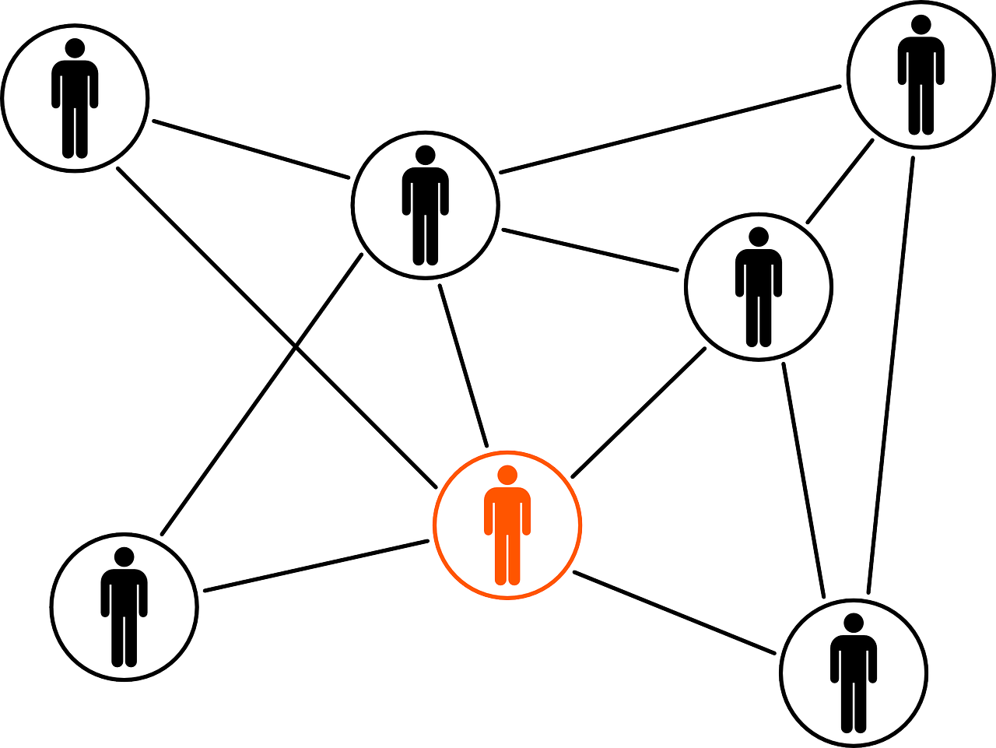
Why Use Discussion Boards
Demonstrate Presence
Create Community
Public Question Platform
Empower Students
Notes:
Brief Introduction

Slide 5
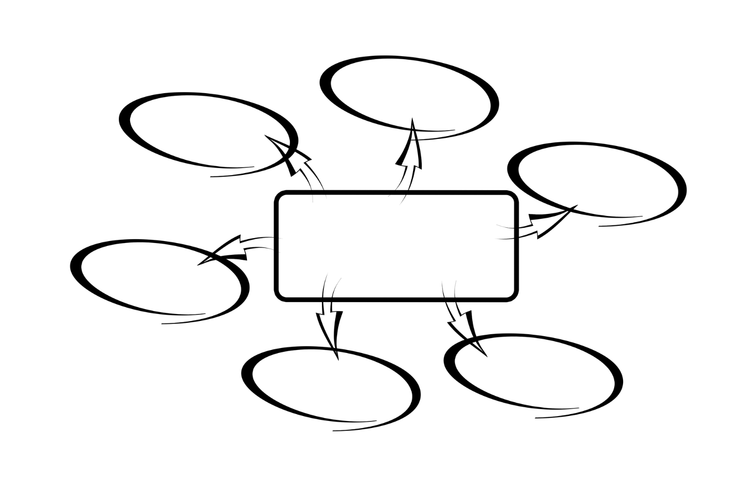
Why Use Discussion Boards
- Demonstrate Presence
Instructor Self-Intro
Instruction
Instructor Presence
  Sage
  Guide
  Ghost
Time for a Poll!
Notes:
Instructor Self-Intro – sets YOUR tone in the course. Consideration: how personal do you want to be? (Example: CNM’s make it personal mandate) Students can sense false camaraderie.
If you are more comfortable being professional in tone, then use that.
If you are naturally a person who shares easily, then use that.
Instruction – This is a place that YOUR explanations can LIVE – You can house Assignment “How To” documents here and let students post questions about them.
Instructor Presence – when we get to the academic uses of DBs, one needs to be aware of the impact of instructor participation in the DBs.
Sage – Perfectly legitimate role, but know that if you are consistently correcting students it will have a stifling effect on the discourse. Also, some students may be offended by what they see as public humiliation.
Guide – In this case, your presence is intended to help usher along a discussion, to ask for clarifications or to suggest further inquiry. This will be harder with the VC branching structure.
Ghost – Perfectly legitimate role, you set up the expectations, then have the students run with the discussion, only coming in to haunt poor posting behavior. This requires an external feedback mechanism.
Poll: Sage, Guide, or Ghost

Slide 6
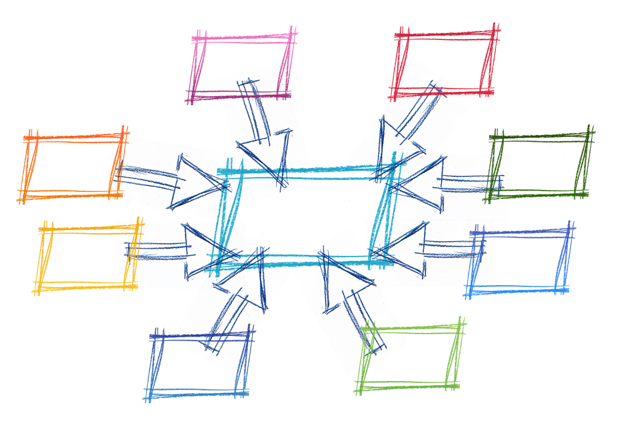
Why Use Discussion Boards
- Creating Community from the Start
Instructor Self-Intro
Student Self-Intro
  Preferred Name
  Grade (?)
  Something Interesting
  Tech Used
    PC
    Mac
    Mobile (OS?)
Responses
Notes:
Discussion boards can be used for entirely non-academic reasons – solely to build community and to offer a safe place for individual student presence.
Instructor Self-Intro – Just talked about this –
Student Self-Intro – Think about what data you can collect from this
Preferred Name (Preferred Pronouns?)
Grade – is everyone always in the same grade – if so, perhaps how do they feel about being in that grade, what are they looking forward to…?
Something Interesting – topical or not topical
Tech Used – this is data for you, it may help to understand why one kid can see everything you are doing and another is missing a connection.
Faculty should respond to EACH STUDENT – personally and with a welcome statement that is not the same for each student. “Welcome to the class, Xavier! I can see you’re using a Chromebook. How do you like its performance?”
Responses – Stimulate positive interaction with extra credit to have students respond to their peers…
Hand Raise: How many of you feel you would like to have at least ONE discussion board in your course which is solely dedicated to non-academic posts?

Slide 7

Why Use Discussion Boards
- Public Question Forum
Student Posed Questions
Academic Discussion
Record of Study
Graded or Pass/Fail
Notes:
Putting up Discussion Boards can give your students a way to see the questions asked by their peers, that can last for the entire semester.
Student Posed Questions: A good Weekly Forum, or a good one to have as a running DB.
Academic Discussion: Proofs – only instructors starting posts can add graphics…
Arguments –
Reactions – Since instructors can post images, links and videos, students can react and see each other’s reactions – creating shared experience (good for music, art, social sciences, or sciences) Idea: link to IQ2
Record of Study: Proofs can be posted here for reference. Test Review forums are also useful.
Graded or Pass/Fail:
Chat: What would you like to link to in a DB?

Slide 8
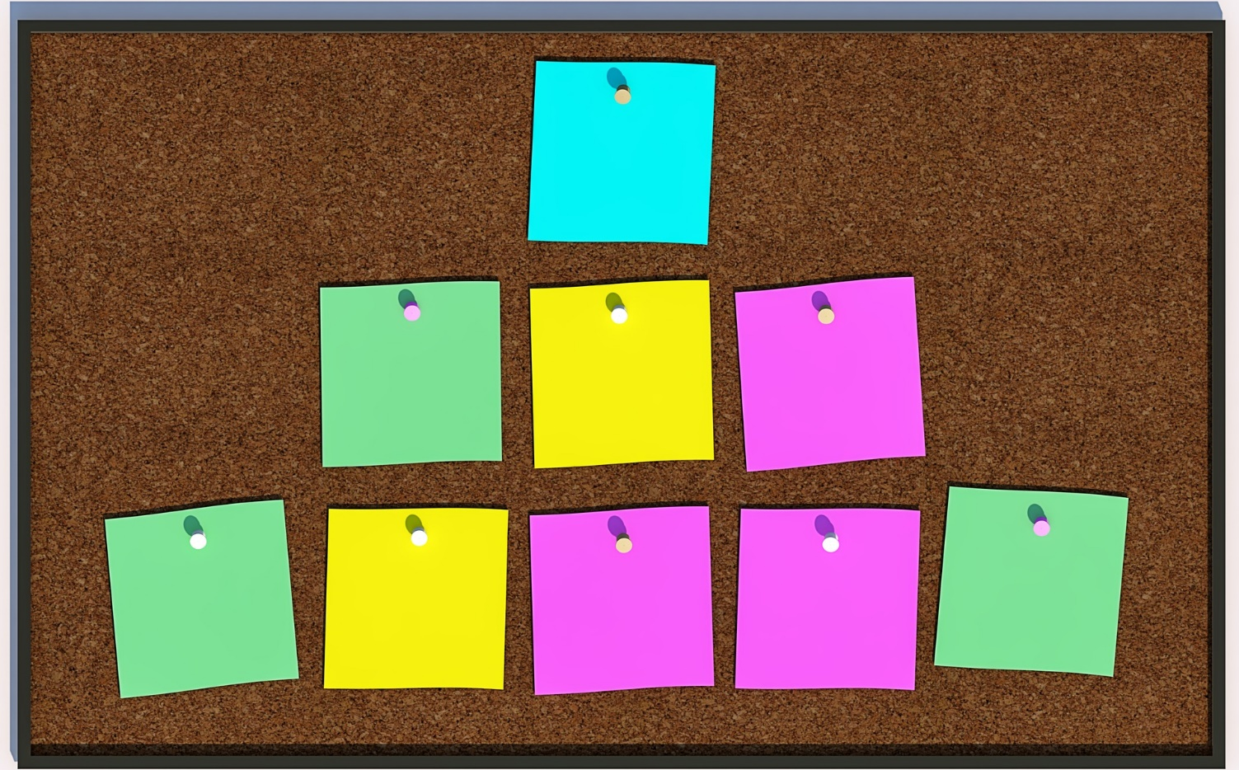
Why Use Discussion Boards
- Empower Students
Teach Model Work
Set Standards Early
Allow Peer Review
Notes:
Teach Model Work: demonstrate what good academic discourse looks like
Set Standards Early in Course: Give students the power to know how to succeed. How much freedom?
Peer Review: both teaching assessment of their peer’s work and empowering them to judge the merits of their own work.
At this point we are going to move from they why to the how… Any questions?

Slide 9

Gradable Discussions
- Function Determines Form
Content
  Subject Matter
  Bloom Level
Roles
  Instructor
  Student
Time for a Poll!
Notes:
Content – What? How?
Roles - What is the instructor’s role? What is the student’s role? Where is this defined?
Poll: Bloom Level for your Discussion Boards?

Slide 10

Gradable Discussions
- Sample Argument Format
5 Sentence Post (No Fluff)
  Thesis
  Introduction to Evidence
  Evidence (with Citation)
  Interpretation
  Analysis
5 Sentence Reply
Instructor Involvement Tapering
Notes:
5 Sentence Post (No Fluff)
Thesis
Introduction to Evidence
Evidence (with Citation)
Interpretation
Analysis
5 Sentence Reply
Instructor Involvement Tapering
Hand Raise: Have any of you tried to implement this sort of format previously? What was your experience?

Slide 11
Gradable Discussions
- Scoring/Rubric
Element | 3 Points | 2 Points | 1 Point | 0 Points
Thesis/Response | Clear well-stated position at the opening of the paragraph. | Clear well-stated position, misplaced in the paragraph. | Weak or unclear position statement. Wavering. | No apparent thesis statement.
Introduction to Evidence | Clear statement of the evidence to be used. The second sentence of the paragraph. | Clear statement of evidence to be used, but not placed in front of the evidence used. | Weak of unclear explanation of the evidence to be used. | No apparent introduction to evidence
Evidence | A quotation from an appropriate source, with citation and in the correct location in the paragraph. | A quotation from an appropriate source, with citation, misplaced in the paragraph. | Quote taken out of context, inappropriately used, or without citation. | No apparent evidence
Interpretation of Evidence | Clear interpretation of the evidence used to make the paragraph’s argument, immediately following the evidence | Clear interpretation of the evidence, misplaced in the paragraph. | Weak or unclear interpretation of the evidence for the purpose of the argument | No apparent interpretation
Analysis | Clear explanation of how this evidence, as interpreted, clarifies the thesis at the start of the paragraph. Placed as the final sentence | Clear explanation of how this evidence, as interpreted, clarifies the thesis at the start of the paragraph – misplaced. | Unclear or weak explanation of the evidence and interpretation’s impact on the thesis. | No clear analysis.
Notes:
Part of making discussions gradable, is ensuring the students have a clear, reliable structure for success.
Rubric – important note – highest immediately to the right of the element – poor score further away
Rubric Location – Should be in Syllabus – needs to be a part of what the students initially see
Raise: How many of you post an example of what a good discussion post looks like?
Questions on Rubrics for DBs?

Slide 12
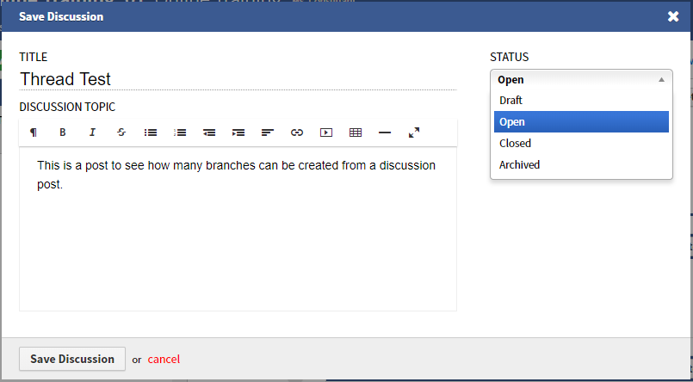
VeraCross Discussion Boards
- Controls
Draft – Not visible
Open – Visible & Writable
Closed – Visible, Not Writable
Archived – Not Visible
Notes:
Draft – Not visible
Open – Visible & Writable
Closed – Visible, Not Writable
Archived – Not Visible
Questions?

Slide 13
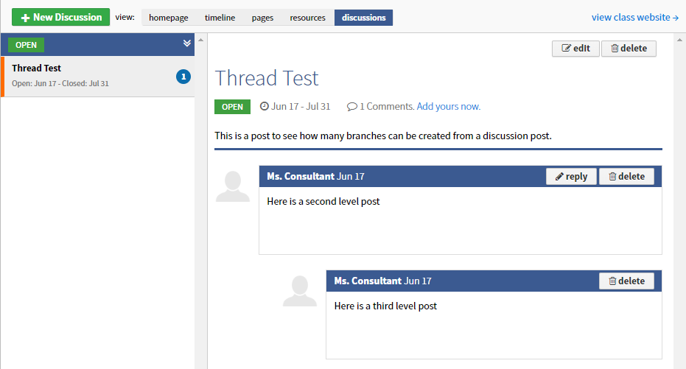
VeraCross Discussion Boards
- Limited Branching Structure
Post – Instructor
Comment – Inst. or Student
Reply – Instructor or Student
Students may not edit once posted
Notes:
Discussions Post – Instructor
Comment – Instructor or Student
Reply – Instructor or Student
Students may not edit once posted
Questions?

Slide 14

Goal-Based Discussion Boards
Community Building
Student Expression
Instructor Presence
Instruction
Record of Study
Academic Discourse
Time for a Poll!
Notes:
Example Non-Academic Use: Anonymous question board for College Counselors. Activity discussion boards
Community Building
Student Expression
Instructor Presence
Instruction
Record of Study
Academic Discourse
Poll: What are your goals in using Discussion Boards?

Slide 15
Questions?
Reactions?
Contact Information:
Susan Boye-Lynn
sboye-lynn@sandiaprep.org
boyelynn@comcast.net
Notes:
Next Week: Assessment Online
Sent out an email yesterday, thank you to those who provided feedback already, please let me know if you have questions.
Final Feedback: What Templates do you need? Or do you? What sort of assignments do you find it difficult to format for online use?

