Slide 1



Pepper and Pear Instructional Design
Using Zoom & Video Well
with Susan Boye-Lynn
Session Notes:
Please keep your mic muted when not speaking
Please open the Participant and Chat windows – use the to raise a question
Be aware that this session is being recorded
Notes:
My Goal: to offer perspectives on online learning, ways to make this work for you and your students
Not: to teach you platforms or tell you what to use
I can only suggest ways that will interlink what you have and set up systems for long-term benefit

Slide 2

What is your best opening activity?
How do you like to welcome your students to each session?
Please write in the chat.
Notes:
Let’s get back to the concept of using each other as resources. To start off this evening, I would like to have you all think about what you have been using to open your courses. Openers have the ability to force participation and timeliness requirements.
How to you start a session? What do the students see? What directions/actions are they asked to take?
Activity: In the chat, please put in your best example of an opening activity. I would like to take a few examples and have people talk through how they use openers to engage students & encourage participation.
Summary: Openers are an integral part of setting the stage for your sessions. Make the tardy ones regret it!

Slide 3

Using Zoom & Video Well
Zoom
  Using Slides
  Working the Functions
  Learnable Chunks
Video
  Linking the Learning
  3-7 Rule
  The Exception
  Last Notes
Notes:
Zoom
Using Slides
Working the Functions
Learnable Chunks
Video
Linking the Learning
3-7 Rule
The Exception

Slide 4
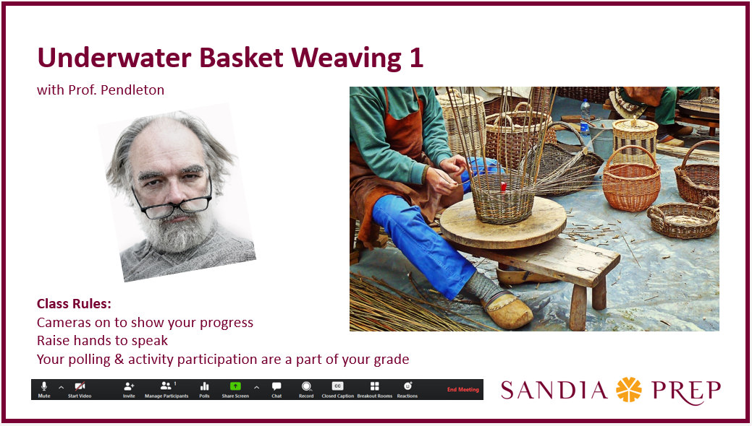
Zoom
– Using Slides
?
Why Slides
Tips
Top Slides
  Course Title & Topic
  Instructor’s Graphic
  Session Rules
  Control Panel
Notes:
Slides help to organize material, provide visual interest, signal changes in topics, and engage the learners. Caveat – instructors who do demos, use whiteboards, or
Tips:
Simple large graphics are best. Think of what is best conceptually, not necessarily about finding the “perfect” graphic.
Hot tip: Pixabay – free, royalty-free photos Good news for educators: fair use allows you to use MOST internet graphics. https://pixabay.com/
Minimal text – topics with very select verbatim text
They do NOT have to take a long time to develop.
Top Slides:
Course Title – reassures learners they are in the right place
Instructor’s graphic – should be clearly a representation of you, but need not be a photo
Session rules – pick the top issues for your course/school environment
Control Panel – this is important for initial usage, but is not so imperative when you know your users already have mastery of the controls
Activity: Poll – what rules would you want on your top slide?

Slide 5

Zoom
- Working the Functions
Raise Hand
Chat
Poll
Breakout Rooms
Share Screen
  Whiteboard
  Present
Camera
Pear Deck
Notes:
The functions for Zoom are like pathways: they can all get you to learning, but some work best for certain types of learning, and people generally want to be able to explore many pathways.
The idea is to select the functions intentionally, and to change the methods uses often.
Raise Hand – Y/N, Attention Check
Chat – Report back, peer to peer clarification
Poll - Info for YOU & comparative data for students
Breakout Rooms – Working Groups for solving or discussing simple issues
Share Screen
Whiteboard – brainstorming & sharing
Present – generally NOT recommended that students do this. Better to have them record presentations via their devices and turn them in directly. If the instructor is using those presentations to teach about presenting or to have students evaluate their peers, then assigning a few to each student will meet this goal.
Camera – level set camera use in your class. I would recommend making it a tool rather than a continual requirement.
Pear Deck – will allow you to use the same sort of presentations deck using Google Slides, but NOT in a Zoom session. This is a really good tool with gradable polling questions. It will save student responses…
Activity: Whiteboard – please select a color & a stamp and react to the various types of activity…
Raise Hand
Chat
Poll
Breakout Rooms
Share Screen
Whiteboard
Present
Camera

Slide 6

Zoom
- Learnable Chunks
Sohlberg & Mateer’s Attention Model
Encoding Learning
5-10 minute Chunks
Level | Description
1. Focused Attention | Response to external stimuli
2. Sustained Attention | Ongoing focus to carry out repetitive tasks
3. Selective Attention | Staying focused while distractions are present
4. Alternating Attention | Shifting focus between tasks that need different skills
5. Divided Attention | Responding simultaneously to multiple tasks
Attention
People Have Short Attention Spans
Use Functions as Microlearning Tools
Encode
Store
Retrieve
Notes:
We discussed last week the Cognitive Load that exists in virtual meetings & meeting participation.
1. Here is part of why: our attention is divided simply by virtue of the intervening medium. Students have to Divide their Attention whenever you ask for a response. Yet, we need them to respond for the sake of ensuring the content was encoded. Part of the message I want to give here, is you need greater patience with responders online than in a classroom. They don’t have the same social pressure to speak that exists when you use a pause in a classroom to elicit response.
2. People have short attention spans: knowing this, we need to make our points and get to an activity which will provide practice, decision-making or summarizing skills regarding our topic. If we want to encode the content, it needs to be repeated, by the learner in a meaningful way.
3. The objective is to use the functions of your platform (in this case Zoom) to provide Microlearning Tools. If you are trying to get across facts, then you want to use a tool that will demonstrate knowledge of facts. If you are trying to have students consider ideas and then form their own opinions through analysis, evaluation or synthesis, then you will want to consider how best that can be conveyed online.
You can share a whiteboard to have students display Line, Space, Shape, Form, Texture, Value and Color. Then send them off to their own drawing pads and share screens in breakout rooms to display their results. If you have given them a form or rubric by which to evaluate the work of their classmates, then they get another level of learning about the basic concepts of visual art.
Chat: What sort of checks do you use to see that students have understood a concept? Please give an example…

Slide 7
Zoom
- Summary
Slides Provide Needed Visual Cues
Zoom Functions are Tools
Chunking Enables Learning
Notes:
Story: 4 part learning objectives for every 5 minutes of teaching…
This is not what I am advocating – instead, I am suggesting that you take the natural nuggets that exist in your content and consider how you can use a Zoom function to check encoding.
https://blog.zoom.us/wordpress/2020/03/27/best-practices-for-securing-your-virtual-classroom/
This brings us to Video

Slide 8
Video
- Linking the Learning
Introduce EVERYTHING (but briefly)
Choose Your Required LOs Wisely
Be Sure They Hear Your Perspective
Keep it Upbeat
Notes:
One of the hardest things we deal with in moving from f2f to online or blended learning is the fear of losing our instructional voice. Instead of being up at the front of the room demonstrating that if you tap a row of flames with a tuning fork the flames will respond to the frequency of the vibration created. Now, you’re having to send your students to a website to see what that looks like, provide a reading, a quiz, and a worksheet to ensure that the same content was covered properly.
While it is possible to videotape and require students to watch hours of lecture each week. You will find that the results will not have the same enthusiastic reception that your in-person self would achieve. With the use of Prep’s videography team, or even from your own desktop, you have another tactic you can use.
1. A way to combat that fear of losing our instructional voice, is to embrace the material you are curating for your students, and give your students an introduction to each learning object you have selected for the week. The more clear you are about what it is and what role it play in their learning for the week, the more likely they are to accept and utilize it.
2. Which means that you have to be very intentional in choosing your required Learning Objects. Think about the entire week, what you want to achieve, and how you can parse out the various goals and objectives across the platforms. Be sure you aren’t just adding something because you just found something that might work. Whatever you pick, you need to put your spin and your approval on it.
3. Be sure they hear your voice, your perspective, on the items. This is the time to discuss your qualms with any part of the material. To give a quick idea to consider as they approach a reading or media file.
4. Finally, keep it upbeat. You don’t have to be Mr. Rogers or Polyanna, but this is going to be a major part of your presence. Which means that you should smile as you talk. (What…?)
Poll: What other forms of video might you want to use in blended learning?

Slide 9

Video
- 3 to 7 Rule
3 – Overview or Content Note Only
5 – Overview with a Note
7 – Demonstrations
Notes:
We have already established that attention spans are LIMITED, and we need to be sure we are (at the same time) giving our student what they need to succeed. So, your best bet is to be brief.
3 – This is an Overview Only or Content Note Only –VOICE THREAD https://voicethread.com/share/14706288/
5 – Overview with a Note – or mini-lecture
7 – Demonstrations
Reactions? Questions?

Slide 10

Video
- The Exception
More is Better than Longer
Put the Date & Sequence in the Title
Notes:
Let’s say you have a topic that just defies these time limits, and you REALLY need to introduce it yourself, but not in class, and not over ZOOM. When it comes to video for online…
The brevity rule does not change! Solutions:
More is Better than Longer – if you are in a bind, and have a full mini-lecture, or series of them as well as needing an overview, then do multiple videos and
be sure to title them with date/week and number at the start. Let the students know in what order to watch them.
Questions: breaking out larger topics?

Slide 11
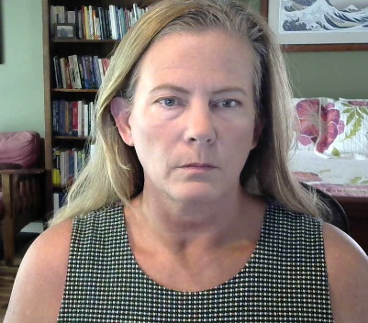

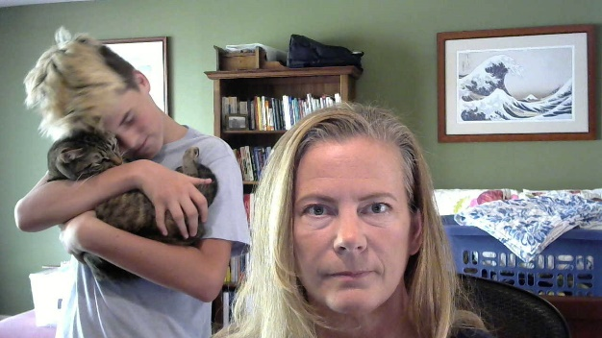


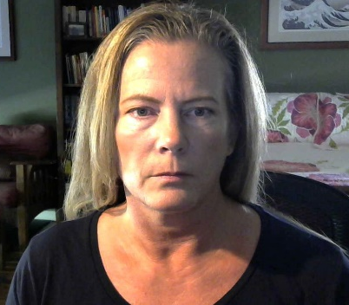

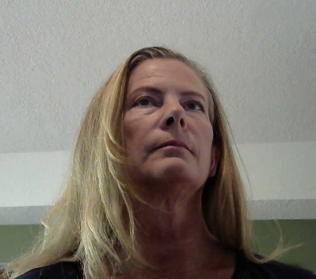
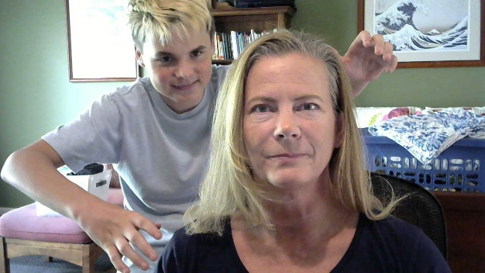
Video
- Last Notes
Camera No-Nos
Beware of Background Distractors
Diffuse Multi-Directional Light
Graphics are Good
Notes:
For the sake of your viewers and good video principles
Camera No-Nos –
Red bleeds
White blanches
Patterns Pixelate or Swim
Tank Tops and Long Hair
Not Above or Below – try to set it up so that it is around forehead level
Beware of Background Distractors – Frame yourself intentionally
Diffuse Multi-Directional Light is best
Interjecting graphics IN your video monologue can be helpful
Offer: If anyone wants a cartoonized image of themselves, please send me a headshot or two, and I will work on it.
Question: Who needs to troubleshoot a video issue?

Slide 12
Useful links:
Free Screen Recording Extension: https://recorder.freebusinessapps.net
Free Audio Recording Software: https://www.audacityteam.org/download/
Pear Deck: https://www.peardeck.com/help-videos
Flubaroo: http://www.flubaroo.com/try-flubaroo-now
Royalty Free & Free Graphics: https://pixabay.com/
Contact Information:
Susan Boye-Lynn
sboye-lynn@sandiaprep.org
boyelynn@comcast.net
Questions?
Reactions?
Notes:
Dump links in CHAT
Next Week: Good Gradable Discussions
Final Feedback: What Templates do you need? Or do you? What sort of assignments do you find it difficult to format for online use?

