Slide 1
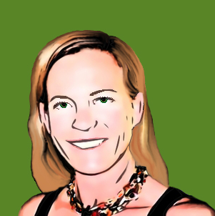
Knowledge Management for Faculty
Created by Susan Boye-Lynn

Slide 2
Conceptual Basis
This model was created while working on an MA in Organizations, Information, and Learning Sciences at University of New Mexico. The goal was to find a knowledge management solution that would work for the specific environment in which we were working.
This project was based on my work as faculty at a community college. Community colleges are plagued by a continually difficult set of issues: need for qualified professional instructors, widely varying funding, uncertain student enrollment, and market pressures which pull faculty away from positions. The result is often a loss of important institutional information as faculty leave for more stable positions and market-based salaries.
Faculty themselves are often pressed for time and resources as the part-time work of most community college instructors requires multiple sections at low pay necessitating another occupation on top of their teaching.
Knowledge management is one way to combat the loss of information and support faculty in having tools which have worked for the student population at that institution. This is an example.

Slide 3
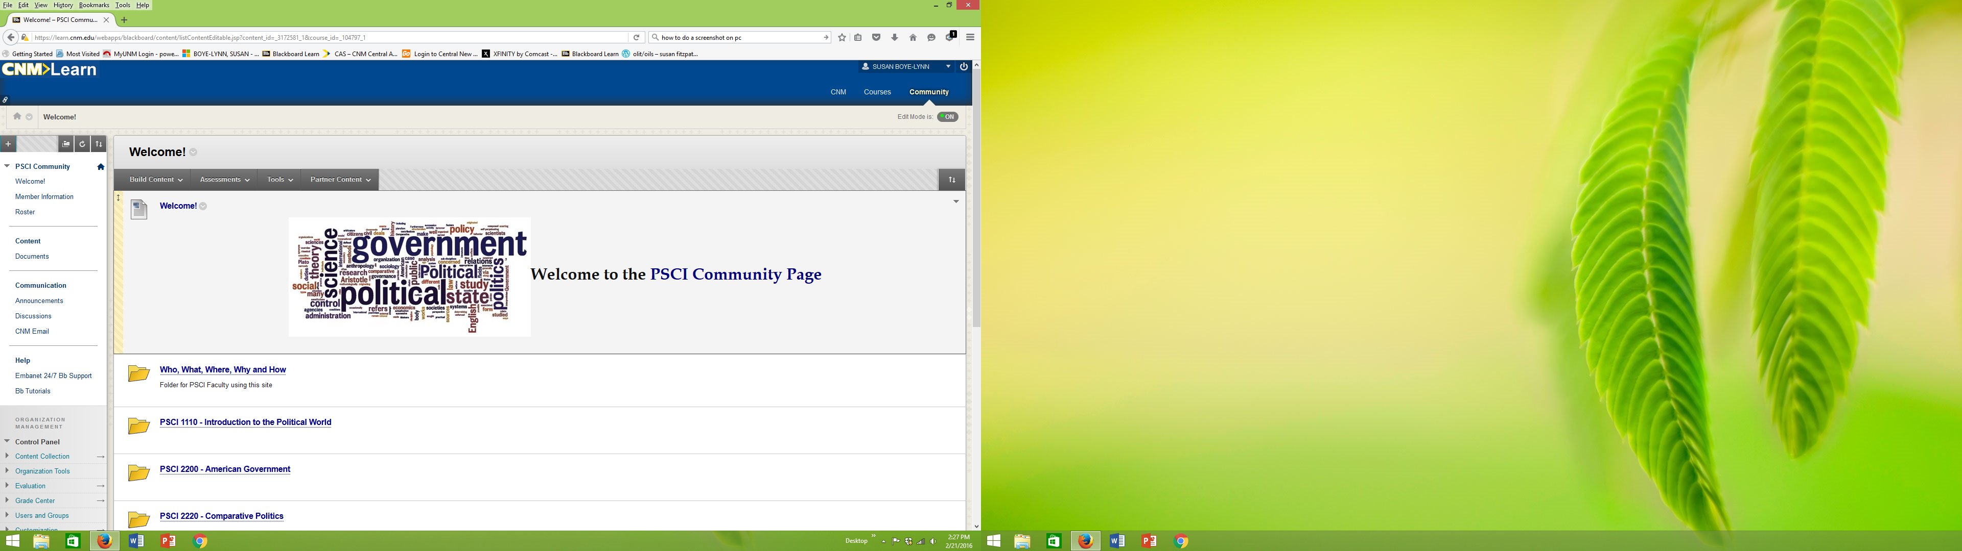
Create a Community Page
Goal –
To create a forum for faculty to use for storing their teaching materials so that colleagues can benefit from each others’ experience and research.

Slide 4

Organize Materials
This website begins with a wiki page so that members of the department may discuss where and how to locate and name materials submitted to the Community Page.
This is an example of the location format that was discussed by faculty.

Slide 5

Naming Protocols Example –
Assignments, Discussion Prompts & Assessments/Test Banks
To find assignments, instructors need to be sure they are clearly and consistently marked.
Important points of reference:
  Text or Faculty Derived (Use Initials)
  Topic
  Form
  Year/Semester
Ex 1: In American Government Course under Assignments one might see:
  SFBL Parley Paper Citizenship 19S
Ex 2: Under Discussion Prompts for Political Ideas:
  KT Citation Argumentation Progression 18F
Ex 3: Text derived discussion prompt set in American Government:
  WTP10 Topical Text Set
Notes:
Graphic retrieved from: https://openclipart.org/detail/115399/ftjabber-protocol

Slide 6
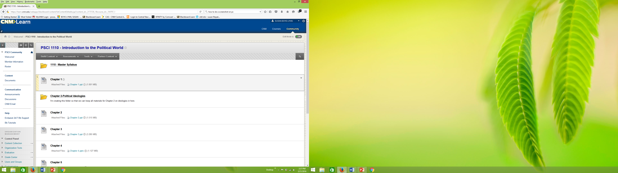
Individual Course Pages
Each course would have a Master Course Page:
Master Syllabus
Publisher Content
Faculty Material
Media Lists/Links
Lecture Notes
Assignments
The goal is to create a rich Master Page the additions to which can be viewed and used by all faculty teaching the same course.
This is not meant to become a mandate, but a set of resource options.

Slide 7

Challenges
Takes time to enter in personally developed materials
Takes thought to consider how and where to enter the materials
Requires instructors to “buy in” to sharing
Many platforms have limited searchability
  Little metadata that can be applied to materials
  No search tool which uses that metadata to find materials
Must all be organized by the users
No clear mechanism for removing materials not in use
Notes:
Graphic retrieved from: https://openclipart.org/detail/168636/challenge-accepted

Slide 8

Proposed Strategy to Encourage Adoption
Put all essential materials for instructors on this platform
  Master Syllabi
  Course/Program Assessment Tools
  Meeting Minutes
  School Memoranda
  Textbook requests
  Web for Faculty Handbook
Provide the example
  Have willing instructors enter and offer materials to begin the exchange
  Post and email instructors regarding available materials
  Open discussions on topics of interest to faculty members
Notes:
Graphic retrieved from: https://openclipart.org/detail/217481/walking-to-the-future

