Slide 1
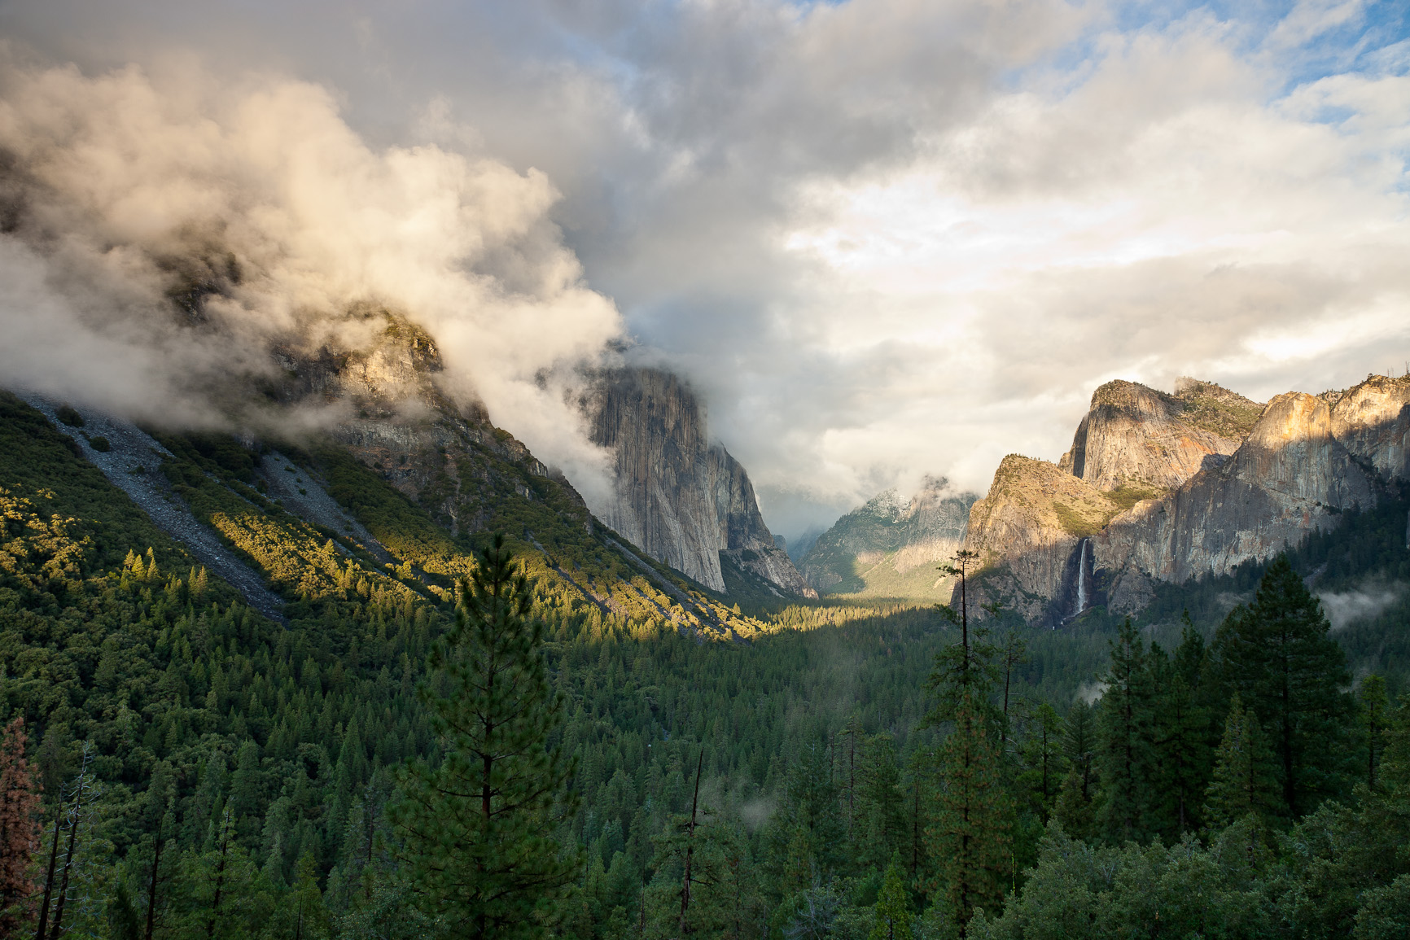
The State of Nature
Teaching Analysis of Political Theories
University of New Mexico
OLIT 533 – Fall 2011
Susan Boye-Lynn

Slide 2
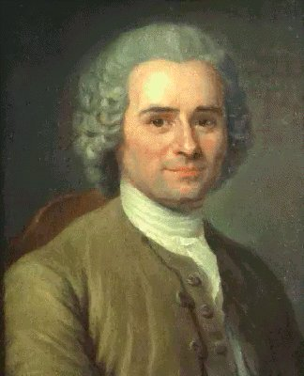
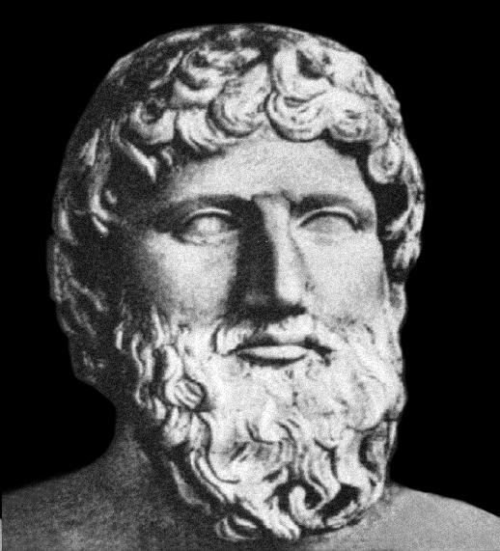
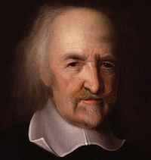
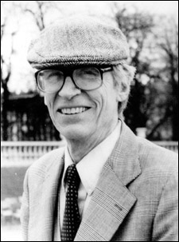
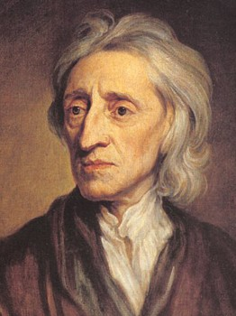
Simulation Project
Description
Create a Simulation for:
American College Freshmen
Introducing State of Nature Theories
Teaching
    Academic Writing
    Analysis
What is a State of Nature Theory:
An argument about how government
came to be, based on the author’s
assumptions about the people.

Slide 3
Learning Objectives:
Discover, Compare, Contrast and Analyze Political Theories
Learning Objectives:
To identify theoretical assumptions with 80% accuracy by the mid-term exam.
To prepare rubrics for framing multiple theoretical assumptions, for use in position papers and analyses, with 80% accuracy by the mid-term exam.
To compare and contrast theories using the Rubric framework to interpret the various theories and the Brief Analysis format to frame the student’s writing.
To critique major theses by writing position papers and analyses, using the Brief Analysis and Theory Paper formats, throughout the second half of the semester.
Final Objectives:
To judge arguments in political theory using the Theory Paper format
Exceptionally: to synthesize or create a Theory Paper illustrating a synthetic or original conception of political thought.

Slide 4
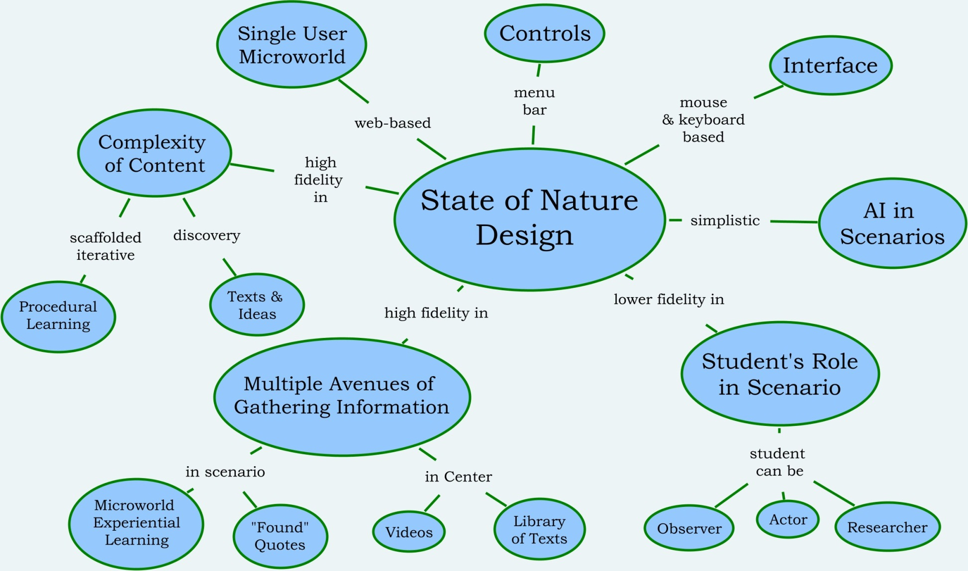
Simulation Design
Overview

Slide 5
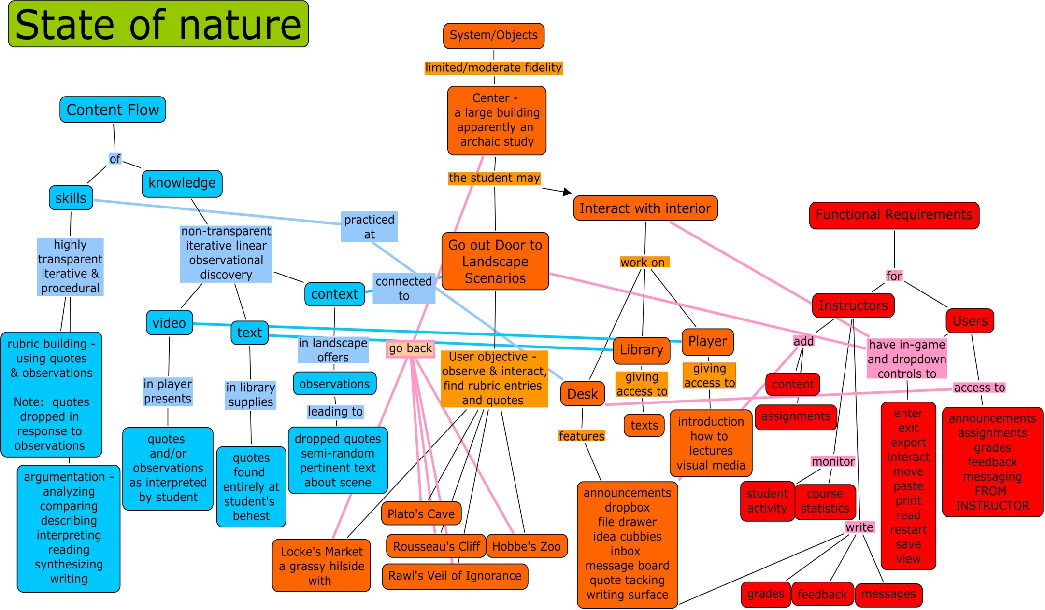
Underlying Model
Notes:
Content Flow shows a divide between the Skills taught and the Knowledge exposure. The course skills are particularly transparent, however the knowledge is not, relying on iterative linear discovery (the Landscape Scenarios) or research learning (in the Center).
System/Objects displays the “physical” options for the students: Starting at the Center one can go out the doors to the Landscape Scenarios or interact with objects within the Center including the Desk, Library and Player.
Functional Requirements addresses how Instructors and Students interact with each other and the content of the course.

Slide 6
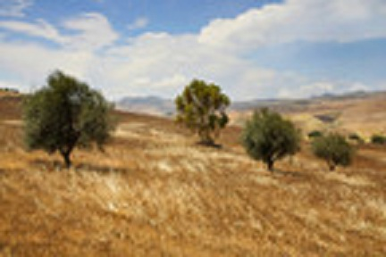
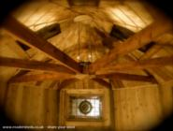
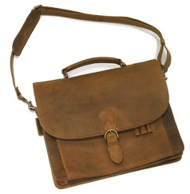
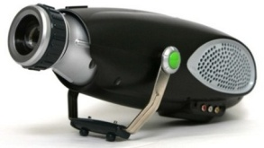

Opening Scenario
Students “fly” over a hillside to a building with many doors
Inside a projector plays a recorded message providing their learning objectives and an introduction to the course
Learner Objects
Center Projector Library Satchel
Notes:
Center: the location where most “classwork” is done. This should be able to be modified by the student into motifs: ancient Mediterranean, Medieval, Rustic (shown), modern or futuristic. This can also be “set” by an instructor for the purposes of future additions to this curriculum when the course material may be focused on any of these eras.
Projector includes tapes for: Introduction, Videos relating to the Primary Source Documents
Projector may also include instructor’s materials: Syllabus, “How to” Teaching Documents, classroom lectures, etc…
Library is the Primary Source writings
Library may have additions made by the instructor.
Satchel holds “dropped quotes” and Notebook
Notebook: can be used to store and “Paste” quotes in to Rubrics, to write notes on observations or quotes discovered in videos or primary source materials. It also can be used as a “portable desk” in that students can elect to receive messages and notifications there, as well as work on papers.

Slide 7
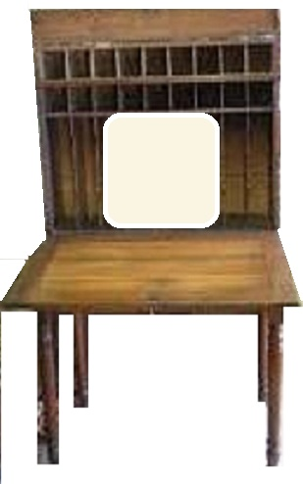
Center Interface & Controls
The Desk – Provides:
Starting Point
Functional Space
Using a Keyboard & Mouse users can access:
Message Board
Announcements
Assignments
Calendar
Dropbox
Feedback
Format Documents
Grades
Messages
Notebook
Position Papers
Quotes
Rubrics
Work in Progress
Calendar
Primary Curriculum Workspace

Slide 8

Student Instructions
Learner Directions – Simulation Start Guide
To Open: Use the mouse to select the State of Nature (SoN) icon.
  SoN will fly users to the Learning Center.
  At the Center, an video will provide initial instruction
Explore the Center: Participation is made simple through the use of the mouse to move and to interact with objects.
  Movement:
    Free Look Mode
    Cursor Mode
  Interaction:
    click on it
    cursor will change depending on function

Slide 9
Tasks & Options
Tasks | Options
Find Quotes | Projector, Library, Landscape Scenarios
Fill in Rubrics | Notebook, Desk
Compare & Contrast Rubrics | Notebook, Desk
Analyze Theories | Notebook, Desk

Slide 10
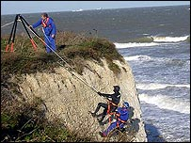
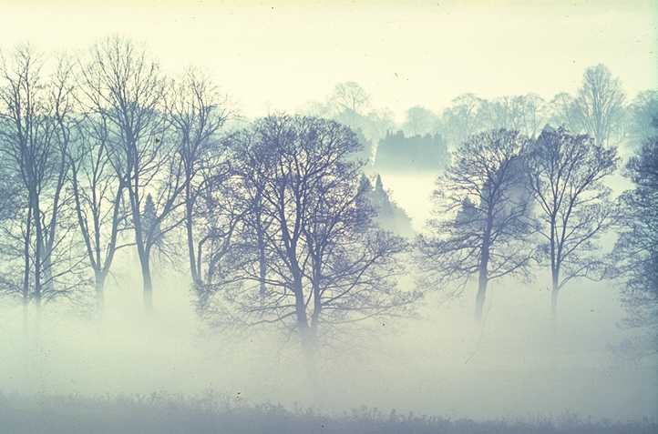

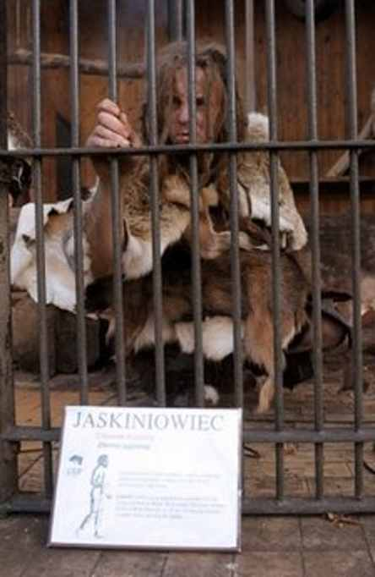
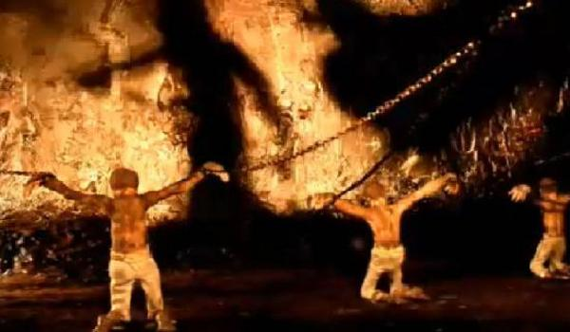
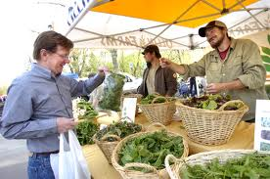
Landscape Scenarios
Choices, choices…
Instructors may select order of scenarios or students may
Each scenario offers the ability to be an observer or actor
Students may collect “dropped quotes” or take notes
Notebook
Rousseau’s Cliff
Rawls’ Veil of Ignorance
Plato’s Cave
Locke’s Market
Hobbes’ Zoo
Notes:
Students are able to leave the Center to explore the various hillside landscapes, within which
they may observe and interact with the scenes, as well as take notes and collect quotes
(which are “dropped” near all the pertinent activities as the student interacts with them and
takes notes) in their Notebook. Interactions in these scenarios will be controlled via mouse.
Each Landscape Scenario is designed to convey some elemental aspect of the author’s work.
Each scenario is effectively linear in content, but the simulation requires multiple iterations
in visiting these sites to collect information which can be compared, contrasted, and analyzed.

Slide 11
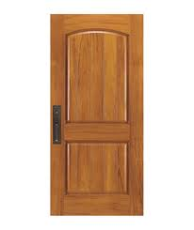
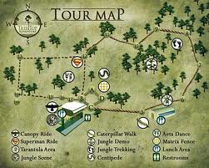
Navigation
Doors
  Author’s Name & Text
  Map lighting areas reached
  Map used to select entry point
Notebook – inside cover
  Map lighting areas reached
  Map to move areas in scenario
Menu Bar
  Start at prior end point
  Return to Desk
  Close program
Warning:
Stay on Path
HobbeS’ Zoo
Leviathan

Slide 12
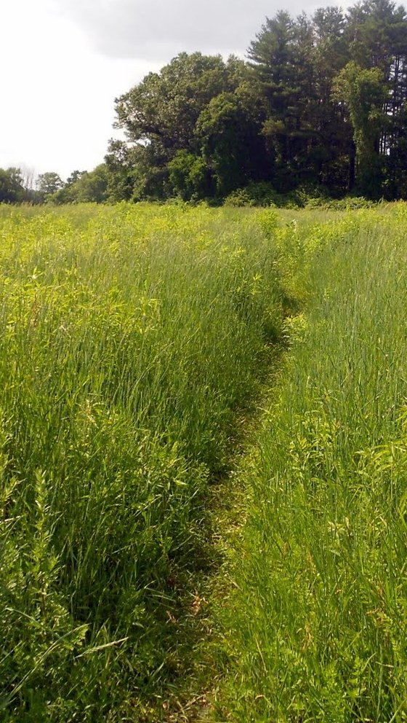
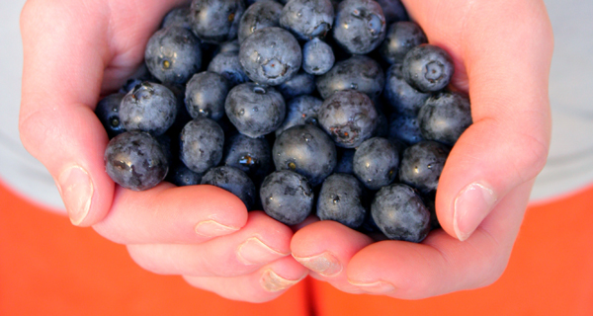
Scenario Options
To be or not to be…
Students may be observers or actors
In Hobbes’ Scenario this could lead to being “mugged” and returned to the Center…
In Locke’s Scenario
one can gain a place
in the market by
using one’s labor…
Students get “real” feedback in scenarios as they interact, or not if they simply observe

Slide 13
Quotes
Quotes can be found in texts or “dropped” in the Landscape Scenarios.
They are born men; they are born free; their liberty belongs to them; no one but themselves has the right to dispose of it. - Rousseau
No man in civil society can be exempted from the laws of it.
- Locke
A sense of justice is the capacity to understand, to apply, and to act from
the public conception of justice which characterizes the fair terms of
social co-operation. - Rawls
Increased interaction increases quote dropping.

Slide 14
Rubrics
Element | Author/Text (Rousseau/The Social Contract)
What is human nature? (good/bad, generous/selfish, etc…) | …
What is the role of government? | “All legitimate authority among men must be based on covenants.”
What is the basic unit of society? | “Each one of us puts into the community his person and all his powers under the supreme direction of the general will…”
What is the definition of “fair”? | …
What is the definition of “freedom”? | “Man acquires with civil society moral freedom, which alone makes man the master of himself; for to be governed by appetite alone is slavery, while obedience to a law one prescribes to oneself is freedom.”

Slide 15

Paper Format
Analytical Paper Structure
Paragraph Layout
Topic sentence – thesis statement
Introduction – to the evidence
Evidence – quote with citation
Interpretation – of the evidence
Analysis – of the argument made
Layout of the papers
Point
Counterpoint
Point

Slide 16
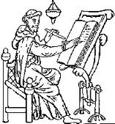
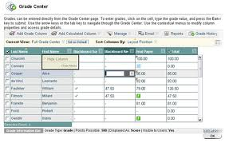
Instructor Controls
Content – Projector: Videos, Video Lectures
- Library: Texts & Lecture Notes
Assignments - alter, amend or add assignments.
Display on a Calendar on the Desk and notebook
Assessments – alter, amend or add tests
Display on a Calendar on the Desk and Notebook
Monitoring – Access to student Notebooks, records of Landscape
Scenario interactions, and access of Center resources.
Statistics - Demonstrate the amount of time in the simulation, average time per session, number of interactions in Landscape Scenarios and Center, & grades.
Grading –Grade Sheets are a part of Desk Options
Feedback – “slips” are “clipped” to the Grade Sheet.
Messaging – Announcements and Messages are promptly
displayed on the Desk and Notebook

Slide 17


Feedback
Students
  Receive
    Grades
    Feedback
    Messages
    “Natural” response
  Submit
    Messages
    Evaluations
Instructors
  Receive
    Student Evaluations
  Submit
    Grades
    Feedback
    Messages
    Simulation Evaluations
Designers Receive
Student Evaluations
Faculty Evaluations

Slide 18
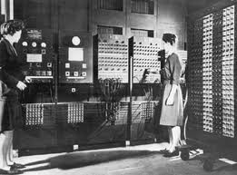
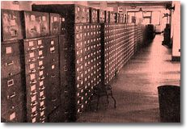
Databases
Content
Primary Texts in Library,
Videos in Projector, and
Quotes from Landscape Scenarios
Course Activity
Monitoring Information
Statistical Information
Course Documents
Argumentation Forms
Assignments
Calendar
Rubric Forms
Sample Work
Syllabus
Help Desk
FAQs
IT
Scenarios
AI
Background
Calculations
Scenery Objects
Sounds
Student Databases
Assignments in Process
Grading & Feedback
Notebook Contents
Quotes on file
Submissions

Slide 19
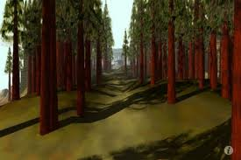
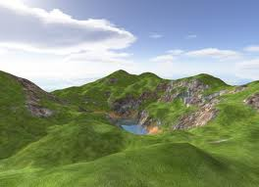
Menus
File
Exit
Export
Paste
Print
Restart
Save
Send
View
Go To
Center
Desk
Library
Notebook
Projector
Quotes
Scenario
Sounds
View
Announcements
Assignments
Calendar
Grades
Feedback
Messaging
Notebook
Rubric
Help
FAQs
Forms
IT
Syllabus
Cursor
Free Look
Cursor Mode
Dropdown Menus allow students to access all areas of
the class regardless
of location in the simulation.

Slide 20
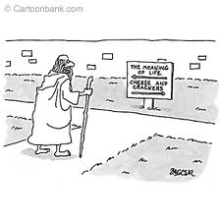
Fin
“They have their exits and their entrances…”
- Shakespeare, As You Like It
Exiting the program
students may: use the Dropdown Menu
press Esc.
The simulation then inquires whether or not that session’s material should be saved.
The State of Nature Simulation is complete when students write their term paper using clear, logical, reasoned analysis illustrated with authors’ quotes.
Exceptional work would include their own ideas.

